Slide 1





Slide 2


Content:
Hypertensin prevalence and statistics
Unmet needs of treated patients
Potential causes and solutions for the unmet needs of treated patients
Hypertension and risk of cardiovascular disease
Cardiovascular disease global burden
Relation between hypertension and cardiovascular disease
Hypertension latest guidelines
The latest ESC/ESH hypertension guidelines
The latest ISH hypertension guidelines
The latest ACC/AHA hypertension guidelines
Unique profile of MICARDIS® (telmisartan)
Antihypertensive beyond benefits
Cardiovascular benefits
ONTARGET Trial
TRANSCEND Trial
Reno-protection
Diabetes mellitus new onset reduction
Single pill combination TWYNSTA® (telmisartan/amlodipine)

Slide 3


Slide 4

Meet Mohamed
A type 2 diabetic patient with stage 2 hypertension*
Age: 40 years old
Blood pressure: 140/90 mmHg
Note: uncontrolled BP
Medications:
Monotherapy Valsartan
Metformin 100mg xr
linagliptin
Aspirin 100 mg
Note: pill burden is problematic for the patient
Family history: father had stroke at age of 60, Mother suffer from MI from age of 50.
* According ACC/AHA 2017 guidelines hypertension classification.

Slide 5
1. Hypertensin prevalence and statistics

Slide 6

The prevalence of hypertension in the GCC region ¹
%
%
~ 2 in 5
Citizens of GCC have hypertension ¹
%
%
%
%
GCC: Gulf Cooperation Council
1.Bhagavathula AS, Shah SM, Aburawi EH. Prevalence, awareness, treatment, and control of hypertension in the United Arab Emirates: a systematic review and meta-analysis. International Journal of Environmental Research and Public Health. 2021 Dec 2;18(23):12693.
Notes:
Average prevalence of hypertension in GCC 37.45%
Which is 1.87 in each 5 persons, so approximately it is 2

Slide 7




Tight control of hypertension with treatment is a major unmeet need of patients¹
Poorly controlled hypertensive patients on treatment
> than 280 million
uncontrolled hypertension patients worldwide although receiving a treatment ^{*1}
Approximately 1 in 2 women and 1 in 2 men receiving treatment for hypertension are poorly controlled ^{*1}
* A pooled analysis of 1201 population-representative studies with 104 million participants, data from 1990 to 2019 on people aged 30–79 years from population-representative studies.
1. Zhou, B., Carrillo-Larco, R.M., Danaei, G., Riley, L.M., Paciorek, C.J., Stevens, G.A., Gregg, E.W., Bennett, J.E., Solomon, B., Singleton, R.K. and Sophiea, M.K., 2021. Worldwide trends in hypertension prevalence and progress in treatment and control from 1990 to 2019: a pooled analysis of 1201 population-representative studies with 104 million participants. The Lancet, 398(10304), pp.957-980.

Slide 8
The reasons for the high proportion of patients with not reaching their BP goals although receiving treatment are varied, but include: ^{1,2}
Adherence problems
Treatment doses that are too low
An absence of synergy between the treatments used
Clinical inertia
1. Hassanein, M., Akbar, M.A., et al. 2022. Management of Diabetes and Hypertension within the Gulf Region: Updates on Treatment Practices and Therapies. Diabetes Therapy, pp.1-28. 2. Chobanian, A.V., Bakris, G.L., Black, H.R., Cushman, W.C., Green, L.A., Izzo Jr, J.L., Jones, D.W., Materson, B.J., Oparil, S., Wright Jr, J.T. and Roccella, E.J., 2003. Seventh report of the joint national committee on prevention, detection, evaluation, and treatment of high blood pressure. hypertension, 42(6), pp.1206-1252.

Slide 9
Potential causes and solutions for the unmet needs of treated patients

Slide 10
The rule of 10: a potential solution for clinical inertia¹
Clinical inertia due to reluctance to initiate or intensify therapy when a patient has not reached the therapeutic goals, is considered to be a major cause of uncontrolled hypertension. ¹
The rule of 10: determining the number of medications needed to reach target BP ^{*1}
Approximate number of medications needed to achieve the patient’s target blood pressure = (current BP – target BP) / 10
* According to the 2015 guidelines of the Taiwan Society of Cardiology and the Taiwan Hypertension Society for the management of hypertension.
BP: Blood pressure.
1. Hassanein, M., Akbar, M.A., et al. 2022. Management of Diabetes and Hypertension within the Gulf Region: Updates on Treatment Practices and Therapies. Diabetes Therapy, pp.1-28.

Slide 11

The rule of 10: the effect of doubling the dose o of antihypertensive drug vs adding another agent ^{*1}
Uncontrolled hypertension on treatment ¹
Doubling the dose
Addition of 2nd drug
– 2mm Hg
– 10 mm Hg
The ‘Rule of 10’ demonstrates that doubling the dose of any one medication will generally result in only a 2 mmHg decrease in SBP, whereas the addition of a second medication can result in a 10 mmHg reduction.¹
* According to the 2015 guidelines of the Taiwan Society of Cardiology and the Taiwan Hypertension Society for the management of hypertension.
SBP: systolic blood pressure
1. Hassanein, M., Akbar, M.A., et al. 2022. Management of Diabetes and Hypertension within the Gulf Region: Updates on Treatment Practices and Therapies. Diabetes Therapy, pp.1-28.

Slide 12

Low treatment adherence among hypertensive patients
Progressive decline in treatment persistence with time ^{1,2}
~ 3 out of 10
patients with hypertension lack treatment adherence¹
50% of patients discontinue their treatment at 1 year
With higher risk of discontinuation among patients aged <40 years ²
* A meta-analysis of 24 studies that measured medication adherence for patients with uncontrolled BP despite being prescribed three or more antihypertensive medications of different classes. By using a random effects model, the pooled prevalence of nonadherence was 31.2% (95% confidence interval = 20.2–44.7, I 2 = 99.50)
1. Durand, H., Hayes, P., Morrissey, E.C., Newell, J., Casey, M., Murphy, A.W. and Molloy, G.J., 2017. Medication adherence among patients with apparent treatment-resistant hypertension: systematic review and meta-analysis. Journal of hypertension, 35(12), pp.2346-2357. 2.Burnier, M. and Egan, B.M., 2019. Adherence in hypertension: a review of prevalence, risk factors, impact, and management. Circulation research, 124(7), pp.1124-1140.

Slide 13
Initial treatment with Single-pill combinations for better treatment adherence and achieving target BP ^{1,2}
28%
15%
Improved treatment adherence
Time to achieve target BP
Single-pill combinations improved adherence compared with the equivalent treatment^{#1}
Single-pill combinations significantly less time to achieve targeted BP within the 1st year of treatment ²
# A Canadian meta-analysis of nine hypertension studies N= 62,481.
* A population-based cohort study of 5 million individuals.
Bp: blood pressure
1. Campana, E., Cunha, V., Glaveckaite, S., Gruev, I., Lamirault, G., Lehmann, E., Masi, S., Kuate, L.M., Mishshenko, L., Ona, D.I. and Oo, M.Z., 2020. The use of single-pill combinations as first-line treatment for hypertension: translating guidelines into clinical practice. Journal of Hypertension, 38(12), pp.2369-2377. 2. Hassanein, M., Akbar, M.A., et al. 2022. Management of Diabetes and Hypertension within the Gulf Region: Updates on Treatment Practices and Therapies. Diabetes Therapy, pp.1-28.

Slide 14
Initial treatment with Single-pill combinations for improved patient outcomes ¹
21%
39%
1-year risk of any cardiovascular event
Risk of ischemic heart disease
Single-pill combinations significantly improves patient outcome compared with free pill combinations ¹
* A population-based cohort study of 5 million individuals.
Bp: blood pressure
1.. Hassanein, M., Akbar, M.A., et al. 2022. Management of Diabetes and Hypertension within the Gulf Region: Updates on Treatment Practices and Therapies. Diabetes Therapy, pp.1-28.

Slide 15
2. Hypertension and risk of cardiovascular disease

Slide 16
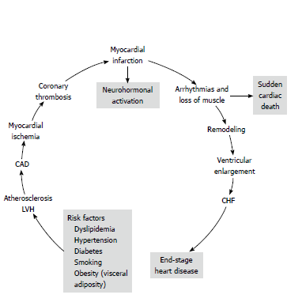

CV disease is progressive¹
The CV disease continuum begins with risk factors that initiate a cascade of processes that cumulate in target-organ damage¹
Atherosclerosis
Remodelling
Ventricular enlargement
Arrhythmias
LVH
CAD
Stroke
CHF
MI
Adapted from ref. 1
Intervention at any point along the continuum can modify CVD progression¹
CAD, coronary artery disease; CHF, congestive heart failure; CVD, Cardiovascular disease; LVH, left ventricular hypertrophy; MI, myocardial infarction;
1. Strauss, M.H., Hall, A.S. and Narkiewicz, K., 2021. The combination of beta-blockers and ACE inhibitors across the spectrum of cardiovascular diseases. Cardiovascular Drugs and Therapy, pp.1-14.

Slide 17
Hindering cardiovascular disease continuum can be achieved by the early diagnosis and treatment of its risk factors ¹
1. Chrysant, S.G., 2010. Stopping the cardiovascular disease continuum: Focus on prevention. World Journal of Cardiology, 2(3), pp.43-49.

Slide 18




The cardiovascular disease: the leading cause of death worldwide ¹
2017 worldwide
2030 worldwide
> 17 million deaths
Predicted 23 million deaths
330 million years of life lost
35.6 million years lived with disability
1.Amini, M., Zayeri, F. and Salehi, M., 2021. Trend analysis of cardiovascular disease mortality, incidence, and mortality-to-incidence ratio: results from global burden of disease study 2017. BMC Public Health, 21(1), pp.1-12.

Slide 19


The cardiovascular disease is the leading cause of death worldwide ¹
~32%
~4 out of 5
global cardiovascular deaths
Causes of global deaths
were due to heart attack and stroke. ¹
32% of global deaths are due to cardiovascular disease. ¹
1. Cardiovascular diseases (cvds) (no date) World Health Organization. World Health Organization. Available at: https://www.who.int/en/news-room/fact-sheets/detail/cardiovascular-diseases-(cvds) (Accessed: October 30, 2022).

Slide 20
The relative risk of death from ischemic heart disease and other vascular causes doubled with each incremental rise in BP (20/10 mmHg BP Increase) ^{*1}
Fold increase in relative CV risk
1-fold
115/75 mmHg
2-fold
135/85 mmHg
4-fold
155/95 mmHg
8-fold
175/105 mmHg
* A meta-analysis of 61 observational studies That included 1 million adults (aged 40–- 89) years
1. Hassanein, M., Akbar, M.A., Al-Shamiri, M., Amir, A., Amod, A., Chudleigh, R., Elhadd, T., Heshmat, H., Jibani, M. and Al Saleh, Y.M., 2022. Management of Diabetes and Hypertension within the Gulf Region: Updates on Treatment Practices and Therapies. Diabetes Therapy, pp.1-28.

Slide 21


Hypertension is a well established risk factor for cardiovascular disease ¹
Each 10-mmhg increase in SBP increased the risk of ^{*1}
45%
65%
Ischemic heart disease
stork
* In those aged 55–64 years.
DBP: diastolic blood pressure, IHD: ischemic heart disease, SBP: systolic blood pressure.
1. Bhagavathula, A.S., Shah, et al., 2021. Prevalence, awareness, treatment, and control of hypertension in the United Arab Emirates: a systematic review and meta-analysis. International Journal of Environmental Research and Public Health, 18(23), p.12693.

Slide 22

High blood pressure is a major risk factors for; the leading cause of death worldwide; the cardiovascular disease ^{1,2}
Over half of ischemic heart disease events and strokes are attributable to high blood pressure ³
1.Bhagavathula, A.S., Shah, et al., 2021. Prevalence, awareness, treatment, and control of hypertension in the United Arab Emirates: a systematic review and meta-analysis. International Journal of Environmental Research and Public Health, 18(23), p.12693. 2 .Amini, M., Zayeri, F. and Salehi, M., 2021. Trend analysis of cardiovascular disease mortality, incidence, and mortality-to-incidence ratio: results from global burden of disease study 2017. BMC Public Health, 21(1), pp.1-12. 3 .Ordunez, P., Campbell, N.R., Arcila, G.P.G., Angell, S.Y., Lombardi, C., Brettler, J.W., Morales, Y.A.R., Connell, K.L., Gamarra, A., DiPette, D.J. and Rosende, A., 2022. HEARTS in the Americas: innovations for improving hypertension and cardiovascular disease risk management in primary care. Revista Panamericana de Salud Pública, 46.

Slide 23
A 10 mm Hg reduction of systolic blood pressure reduces the risk of:¹
Major cardiovascular disease events
Coronary heart disease
Heart failure
28%
20%
17%
(RR= 0.80, 95% CI= 0.77 - 0.83)
(RR= 0.83, 95% CI= 0.78 - 0.88)
(RR= 0.72, 95% CI= 0.67 to 0.78)
Death from all causes
13%
Stroke 27%
(RR= 0.87, 95% CI= 0.84 to 0.91)
(RR= 0.73, 95% CI= 0.68 to 0.77)
* A meta-analysis
RR: relative risk, CI: confidence interval
1. Ettehad, D., Emdin, C.A., Kiran, A., Anderson, S.G., Callender, T., Emberson, J., Chalmers, J., Rodgers, A. and Rahimi, K., 2016. Blood pressure lowering for prevention of cardiovascular disease and death: a systematic review and meta-analysis. The Lancet, 387(10022), pp.957-967.

Slide 24
3. Hypertension Guidelines

Slide 25


The latest ESC/ESH hypertension guidelines

Slide 26
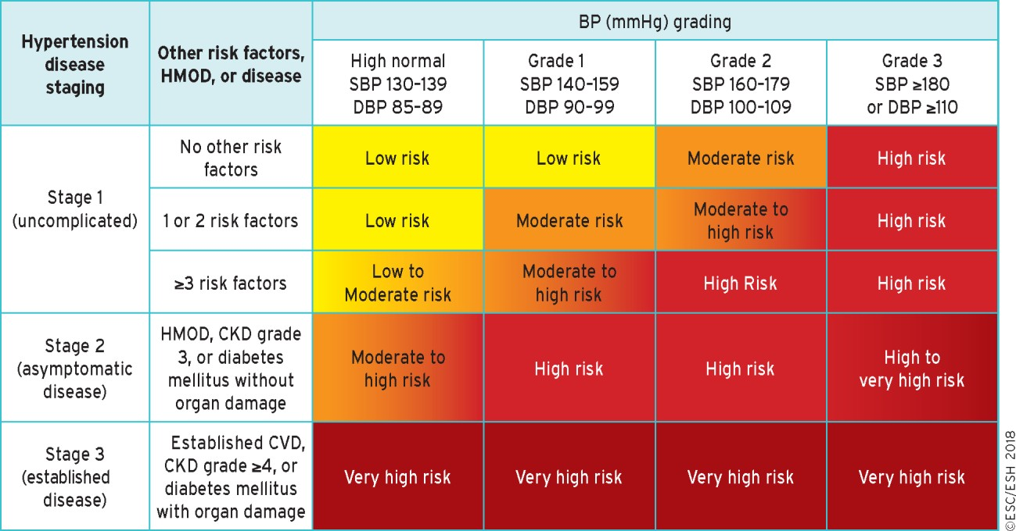
ESH/ESC 2018 Hypertension Guidelines Classification of hypertension stages according to blood pressure levels, presence of cardiovascular risk¹
Hypertension is defined as values ≥ 140 mmHg SBP or/and ≥ 90 mmHg DBP, base on evidence from RCT¹
1. Williams B, Mancia G, Spiering W, et al. 2018 ESC/ESH Guidelines for the management of arterial hypertension [published correction appears in Eur Heart J. 2019 Feb 1;40(5):475]. Eur Heart J. 2018;39(33):3021-3104.

Slide 27
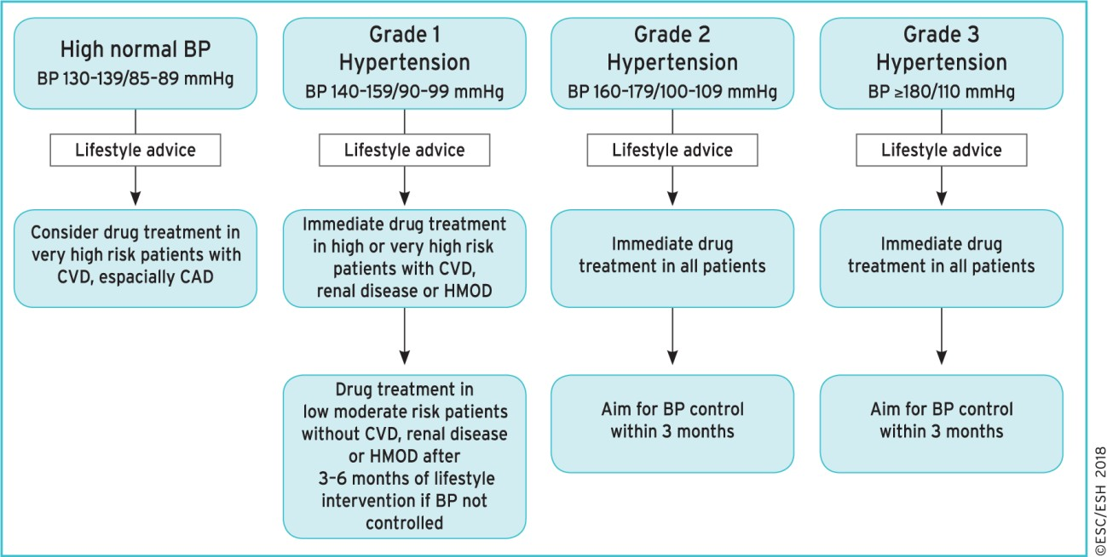
ESH/ESC 2018 Hypertension Guidelines
Initiation of blood pressure-lowering treatment (lifestyle changes and medication) at different initial¹
1. Williams B, Mancia G, Spiering W, et al. 2018 ESC/ESH Guidelines for the management of arterial hypertension [published correction appears in Eur Heart J. 2019 Feb 1;40(5):475]. Eur Heart J. 2018;39(33):3021-3104.

Slide 28
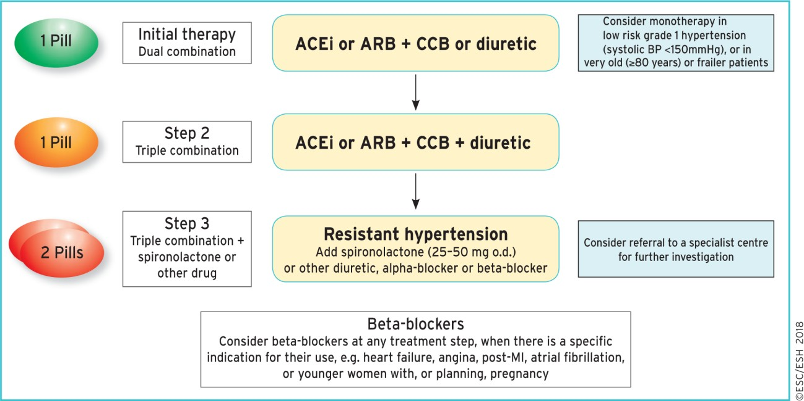
ESH/ESC 2018 Hypertension Guidelines
Core drug treatment strategy for uncomplicated hypertension. The core algorithm is also appropriate for most patients with HMOD (hypertension-mediated organ damage¹
ACEi: Angiotensin converting enzyme inhibitor, ARB: Angiotensin receptor blocker, CCB: calcium channel blocker
1. Williams B, Mancia G, Spiering W, et al. 2018 ESC/ESH Guidelines for the management of arterial hypertension [published correction appears in Eur Heart J. 2019 Feb 1;40(5):475]. Eur Heart J. 2018;39(33):3021-3104.

Slide 29
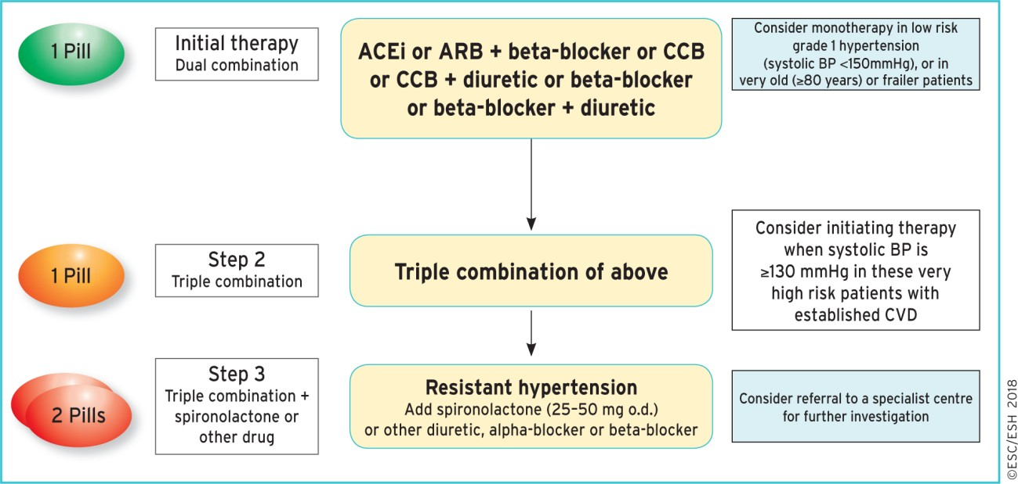
ESH/ESC 2018 Hypertension Guidelines
Drug treatment strategy for hypertension and coronary artery disease¹
ACEi: Angiotensin converting enzyme inhibitor, ARB: Angiotensin receptor blocker, CCB: calcium channel blocker
1. Williams B, Mancia G, Spiering W, et al. 2018 ESC/ESH Guidelines for the management of arterial hypertension [published correction appears in Eur Heart J. 2019 Feb 1;40(5):475]. Eur Heart J. 2018;39(33):3021-3104.

Slide 30
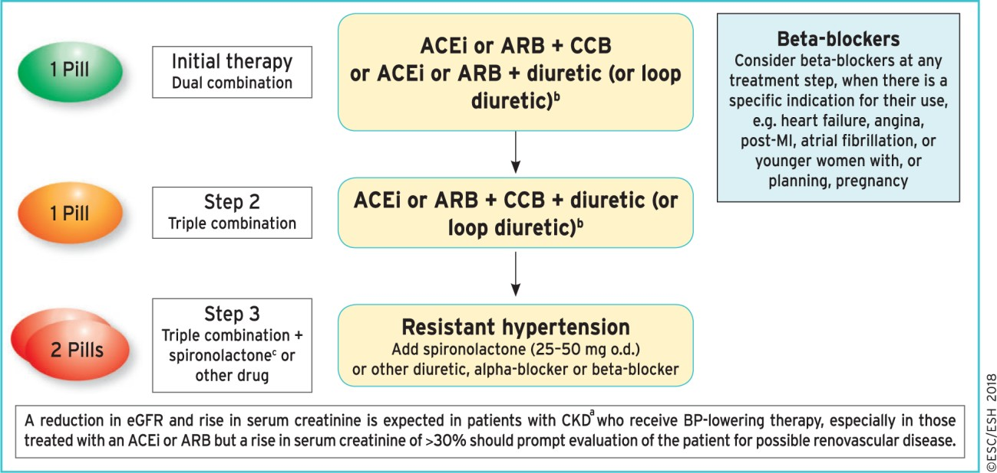
2018 ESH/ESC Guideline Hypertension
Drug treatment strategy for hypertension and chronic kidney disease.¹
Adapted from ref. 1
ªCKD is defined as an eGFR <60 mL/min/1.72 m² with or without proteinuria.
^{b}Use loop diuretics when eGFR is <30 mL/min/1.72 m², because thiazide/thiazide-like diuretics are much less effective/ineffective when eGFR is reduced to this level.
^{c}Caution: risk of hyperkalaemia with spironolactone, especially when eGFR is <45 mL/min/1.72 m² or baseline Kþ ≥4.5 mmol/L.
ACEi: Angiotensin converting enzyme inhibitor, ARB: Angiotensin receptor blocker, CCB: calcium channel blocker
1. Williams B, Mancia G, Spiering W, et al. 2018 ESC/ESH Guidelines for the management of arterial hypertension [published correction appears in Eur Heart J. 2019 Feb 1;40(5):475]. Eur Heart J. 2018;39(33):3021-3104.

Slide 31
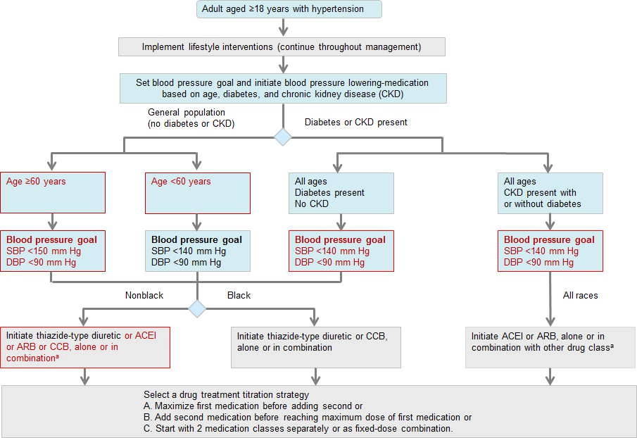
JNC 8 Treatment Strategies: Hypertension Guideline Management Algorithm¹
ª ACEIs and ARBs should not be used in combination.
ACEi: Angiotensin converting enzyme inhibitor, ARB: Angiotensin receptor blocker, JNC=Joint National Committee.
1. James PA, Oparil S, Carter BL, et al. 2014 evidence-based guideline for the management of high blood pressure in adults: report from the panel memb appointed to the Eighth Joint National Committee (JNC 8) [published correction appears in JAMA. 2014 May 7;311(17):1809]. JAMA. 2014;311(5):507-520.
ers

Slide 32




Prescription of an appropriate therapeutic regimen is crucial. This might be achieved through:¹
Using long-acting drugs that require once daily dosage
single-pill combinations whenever possible
Avoiding complex dosing schedules
Possible drug-related adverse events
1. Williams B, Mancia G, Spiering W, et al. 2018 ESC/ESH Guidelines for the management of arterial hypertension [published correction appears in Eur Heart J. 2019 Feb 1;40(5):475]. Eur Heart J. 2018;39(33):3021-3104.

Slide 33


The renin-angiotensin system (RAS) is a major target for antihypertensive therapy^{1,2}
Angiotensin I
Angiotensin converting
X
ACE inhibitors
enzyme (ACE)
Angiotensin II
X
Angiotensin receptor blockers (ARBs) e.g. telmisartan
AT₁ receptor
VSMC
Growth, contraction, hypertrophy, fibrosis
Endothelial cells NO imbalance, dysfunction, adhesion
Cardiac cells Hypertrophy, remodelling, conduction disturbance
ECM
Synthesis, degradation, adhesion, cytokine induction
Inflammation, atherosclerosis, thrombosis, fibrosis
Adapted from ref. 1, 2
2018 ESH/ESC guideline recommendations
ARBs (e.g. telmisartan), ACE inhibitors, thiazides and thiazide-like diuretics, β-blockers, and calcium channel blockers are recommended for antihypertensive treatment (as combination or monotherapy)³
ECM: extracellular matrix, NO: nitric oxide, VSMC: vascular smooth muscle cell.
1. Mehta PK, Griendling KK. Angiotensin II cell signaling: physiological and pathological effects in the cardiovascular system. Am J Physiol Cell Physiol. 2007;292(1):C82- C97. 2. Verdecchia P, Gentile G, Angeli F, Reboldi G. Beyond blood pressure: evidence for cardiovascular, cerebrovascular, and renal protective effects of renin- angiotensin system blockers. Ther Adv Cardiovasc Dis. 2012;6(2):81-91. 3. Williams B, Mancia G, Spiering W, et al. 2018 ESC/ESH Guidelines for the management of arterial hypertension [published correction appears in Eur Heart J. 2019 Feb 1;40(5):475]. Eur Heart J. 2018;39(33):3021-3104.

Slide 34

The latest ISH hypertension guidelines

Slide 35
The latest guidelines
Ideal hypertension treatment should be evidence-based in relation to its ability to prevent morbidity and mortality. ¹
1. Hassanein, M., Akbar, M.A., et al. 2022. Management of Diabetes and Hypertension within the Gulf Region: Updates on Treatment Practices and Therapies. Diabetes Therapy, pp.1-28.

Slide 36
ISH 2020 guidelines optimal recommendations ¹
Step 1
Dual low- dose combination
ACEi + DHP-CCB or ARB + DHP-CCB ^{a,b,c}
Step 2
Dual full- dose combination
ACEi + DHP-CCB or ARB + DHP-CCB ^{a,b,}
Ideally single pill combination therapy
Step 3
Triple combination
ACEi + DHP-CCB + thiazide-like diuretic
or ARB + DHP-CCB + thiazide-like diuretic
Step 4
(Resistant hypertension)
Triple combination
+ spironolactone or other drug
ACEi + DHP-CCB + thiazide-like diuretic
or ARB + DHP-CCB + thiazide-like diuretic ^{d}
+ spironolactone
a: consider monotherapy in low risk grade 1 hypertension or in ≥80 years or failure patients.
b: ACEi or ARB plus DHP-CCB in post stroke patients, very elderly , incipient HF or CCB intolerance.
c: consider ACEi or ARB plus DHP-CCB or DHP-CCB + thiazide like diuretic.
d: caution with spironolactone or other potassium sparing diuretics when eGFR <45 ml/min/1.73m² or K+ > 4.5 mmol/L.
ACEi: Angiotensin converting enzyme inhibitor, ARB: Angiotensin receptor blocker, DHP-CCB: dihydropyridine-calcium channel blocker ISH: international society of hypertension
1.Unger, T., Borghi, C., Charchar, F., Khan, N.A., Poulter, N.R., Prabhakaran, D., Ramirez, A., Schlaich, M., Stergiou, G.S., Tomaszewski, M. and Wainford, R.D., 2020. 2020 International Society of Hypertension global hypertension practice guidelines. Hypertension, 75(6), pp.1334-1357.

Slide 37


The latest ACC/AHA hypertension guidelines

Slide 38
The latest ACC/AHA hypertension guidelines: blood Pressure Classification ^{1,2}
BP Category | SBP |  | DBP
Normal | <120 mm Hg | and | <80 mm Hg
Elevated | 120–129 mm Hg | and | <80 mm Hg
Hypertension
Stage 1 | 130–139 mm Hg | or | 80–89 mm Hg
Stage 2 | ≥140 mm Hg | or | ≥90 mm Hg
Hypertensive crisis | >180 | and/or | >120
ACC/AHA guidelines latest update eliminate the category of prehypertension, previous guidelines classified 140/90 mm Hg as Stage 1 hypertension, this level is classified currently as Stage 2 hypertension under the new guidelines. ^{1,2}
BP: blood pressure, DBP: Diastolic blood pressure, SBP: systolic blood pressure.
1.Whelton, P.K., Carey, R.M., Aronow, W.S., et. al, E.J., 2018. 2017 ACC/AHA/AAPA/ABC/ACPM/AGS/APhA/ASH/ASPC/NMA/PCNA guideline for the prevention, detection, evaluation, and management of high blood pressure in adults: a report of the American College of Cardiology/American Heart Association Task Force on Clinical Practice Guidelines. Journal of the American College of Cardiology, 71(19), pp.e127-e248.
2.New ACC/AHA high blood pressure guidelines lower definition of hypertension (2017) American College of Cardiology. Available at: https://www.acc.org/latest-in-cardiology/articles/2017/11/08/11/47/mon-5pm-bp-guideline-aha-2017 (Accessed: October 31, 2022).

Slide 39
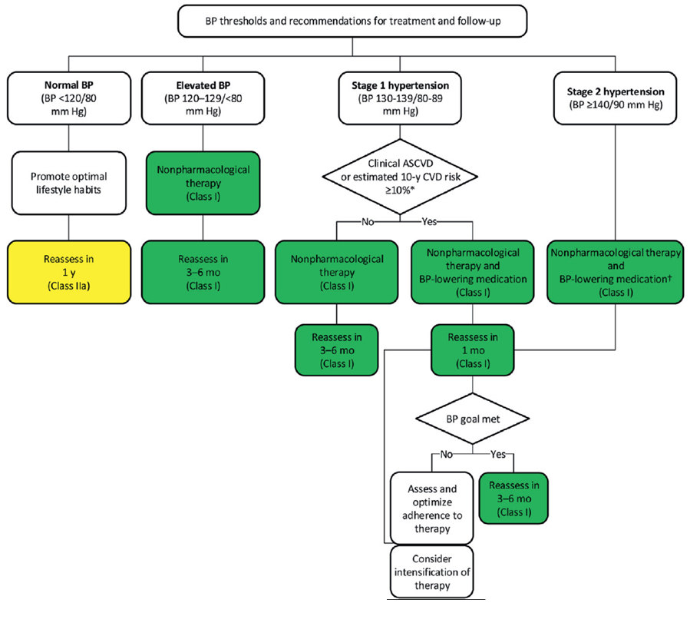
The latest ACC/AHA guidelines
BP threshold for initiating antihypertensive drug therapy¹
Prescribing medication for stage I hypertension is recommended if :
Previous cardiovascular event such as a heart attack or stroke.
High risk of heart attack or stroke based on age.
Diabetes mellitus.
Chronic kidney disease.
10-year atherosclerotic CVD risk ≥10%*
* Based on estimation using of the ACC/AHA Pooled Cohort Equations calculator.
1.Whelton, P.K., Carey, R.M., Aronow, W.S., et. al, E.J., 2018. 2017 ACC/AHA/AAPA/ABC/ACPM/AGS/APhA/ASH/ASPC/NMA/PCNA guideline for the prevention, detection, evaluation, and management of high blood pressure in adults: a report of the American College of Cardiology/American Heart Association Task Force on Clinical Practice Guidelines. Journal of the American College of Cardiology, 71(19), pp.e127-e248.

Slide 40
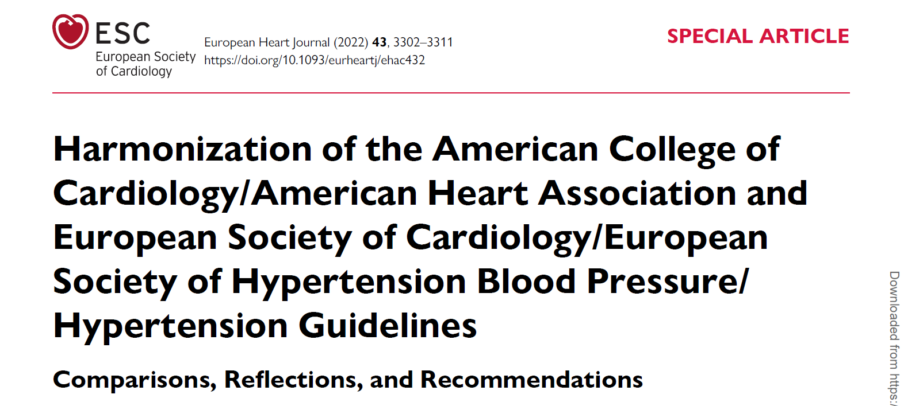
The latest ACC/AHA & ESC/ESH hypertension guidelines 2022 recommendations ¹
Antihypertensive Drug Therapy for Management of Hypertension
ACC/AHA guidelines recommends | ESC/ESH guidelines recommends
Treatment strategy
Combination therapy is required in most patients and is specifically recommended in: African Americans Adults with a starting SBP/DBP= 20/10 mm Hg above the BP treatment target. | Initial combination therapy with ACE inhibitors or ARB plus CCB or diuretic recommended in most patients with hypertension, with the use of single-pill combinations strongly favored.
* Based on estimation using of the ACC/AHA Pooled Cohort Equations calculator.
If no compelling indication for drug choice, consider initial 2-drug combination. CCB plus ARBs combination as one of the recommendations of primary agents, favoring single pill combination. ¹
Angiotensin receptor blockers; CCB: calcium channel blockers.
1. Whelton, P.K., Carey, et. al., 2022. Harmonization of the American College of Cardiology/American Heart Association and European Society of Cardiology/European Society of Hypertension Blood Pressure/Hypertension Guidelines: Comparisons, Reflections, and Recommendations. European heart journal, 43(35), pp.3302-3311.

Slide 41




The latest ACC/AHA guidelines encourages single pill combinations when possible
Rx
Rx
SPC
Patient consistency
Recognizing that many people will need two or more types of medications to control their blood pressure.¹
Single pill combination may increase patient consistency. ¹
SPC: single pill combination.
1. Whelton, P.K., Carey, et. al., 2022. Harmonization of the American College of Cardiology/American Heart Association and European Society of Cardiology/European Society of Hypertension Blood Pressure/Hypertension Guidelines: Comparisons, Reflections, and Recommendations. European heart journal, 43(35), pp.3302-3311.

Slide 42
The latest ACC/AHA hypertension guidelines recommends ¹
CVD/ASCVD Risk Assessment
ACC/AHA guidelines recommends risk stratification for all adults with hypertension but especially important for treatment decisions in adults with stage 1 hypertension (confirmed systolic blood pressure 130–139 mm Hg or diastolic blood pressure 80–89 mm Hg). ¹
CVD risk based on history of CVD or 10-year ASCVD risk ≥10% in adults 40–79 years of age. * | CVD risk based on history of CVD or 10-year ASCVD risk ≥10% in adults 40–79 years of age. *
Higher-risk category | CVD or 10-year ASCVD risk ≥10%
Lower-risk category | no CVD and 10-year ASCVD risk <10%
Lifetime risk assessment encouraged in younger adults.
* Using the ACC/AHA Pooled Cohort Equations
1. Whelton, P.K., Carey, et. al., 2022. Harmonization of the American College of Cardiology/American Heart Association and European Society of Cardiology/European Society of Hypertension Blood Pressure/Hypertension Guidelines: Comparisons, Reflections, and Recommendations. European heart journal, 43(35), pp.3302-3311.

Slide 43
The latest ACC/AHA hypertension guidelines
Recommendations for treatment targets:
<130/80 mm Hg target
SBP <130 mm Hg
For older adults with a high burden of comorbidity and
limited life expectancy, treatment decisions should be
based on clinical judgment, patient preference, and a
team-based assessment of risk/benefit.
For older adults (≥65 years),
who are noninstitutionalized, ambulatory, and community
dwelling, the target is, if tolerated.
Recommended for all adults with hypertension
1. Whelton, P.K., Carey, et. al., 2022. Harmonization of the American College of Cardiology/American Heart Association and European Society of Cardiology/European Society of Hypertension Blood Pressure/Hypertension Guidelines: Comparisons, Reflections, and Recommendations. European heart journal, 43(35), pp.3302-3311.

Slide 44
The latest ACC/AHA hypertension guidelines
Initial monotherapy versus initial combination drug therapy ^{1,2}
Recommendations for choice of initial monotherapy versus initial combination drug therapy ¹
Adults with stage 1 hypertension and BP goal <130/80 mm Hg | Initiate a single antihypertensive drug | dosage titration and sequential addition of other agents to achieve the BP target
Adults with stage 2 hypertension and BP >20/10 mm Hg above their BP target | Initiate 2 first-line agents of different classes | separate agents or in a fixed-dose combination
If there is no compelling clinical indication for selection of a BP-lowering medication, treat with ≥1 drugs from the following classes: diuretics, CCBs, ACE inhibitors, or ARBs. ^{1,2}
Combination therapy is required in most patients and is specifically recommended:
African Americans
Adults with a starting SBP/DBP ≥20/10 mm Hg above the BP treatment target.
Dual- and triple-drug therapy should include agents with complementary mechanisms of action. ^{1,2}
1.Whelton, P.K., Carey, R.M., Aronow, W.S., et. al, E.J., 2018. 2017 ACC/AHA/AAPA/ABC/ACPM/AGS/APhA/ASH/ASPC/NMA/PCNA guideline for the prevention, detection, evaluation, and management of high blood pressure in adults: a report of the American College of Cardiology/American Heart Association Task Force on Clinical Practice Guidelines. Journal of the American College of Cardiology, 71(19), pp.e127-e248.
2. Whelton, P.K., Carey, et. al., 2022. Harmonization of the American College of Cardiology/American Heart Association and European Society of Cardiology/European Society of Hypertension Blood Pressure/Hypertension Guidelines: Comparisons, Reflections, and Recommendations. European heart journal, 43(35), pp.3302-3311.

Slide 45


4. UNIQUE PROFILE OF MICARDIS® (telmisartan)

Slide 46
MICARDIS® (telmisartan) unique pharmacology profile in its class (ARB)
Longest plasma half-life ¹
Highest receptor affinity ²
24
Receptor dissociation half-life (min)
213
Plasma half-life (h)
24
200
166
18
15
150
133
12
13
12
9
100
81
7
8
70
6
50
0
0
Epro- sartan
Lo- sartan
Val- sartan
Cande- sartan
Olme- sartan
Telmi- sartan
Lo- sartan
Val- sartan
Cande- sartan
Olme- sartan
Telmi- sartan
1. Asmar R. Targeting effective blood pressure control with angiotensin receptor blockers. Int J Clin Pract. 2006;60(3):315-320. 2. Kakuta H, Sudoh K, Sasamata M, Yamagishi S. Telmisartan has the strongest binding affinity to angiotensin II type 1 receptor: comparison with other angiotensin II type 1 receptor blockers. Int J Clin Pharmacol Res. 2005;25(1):41-46.3. Benson SC, Pershadsingh HA, Ho CI, et al. Identification of telmisartan as a unique angiotensin II receptor antagonist with selective PPARgamma-modulating activity. Hypertension. 2004;43(5):993-1002.

Slide 47
MICARDIS® (telmisartan) unique pharmacology profile in its class (ARB)
Most lipophilic ¹
(high tissue penetration)
500
Highest selective PPARγ activation ³
Volume of distribution (L)
500
† Active metabolite of losartan
30
PPARy fold activation
100
93
25
80
20
60
15
40
34
10
20
13
17
17
5
9
0
Cande- sartan
Epro- sartan
Val- sartan
Olme- sartan
Lo- sartan
Irbe- sartan
Telmi- sartan
0
Epro- Olme- sartan sartan
EXP Cande- Val- Irbe- Telmi- 3174† sartan sartan sartan sartan
1. Asmar R. Targeting effective blood pressure control with angiotensin receptor blockers. Int J Clin Pract. 2006;60(3):315-320. 2. Kakuta H, Sudoh K, Sasamata M, Yamagishi S. Telmisartan has the strongest binding affinity to angiotensin II type 1 receptor: comparison with other angiotensin II type 1 receptor blockers. Int J Clin Pharmacol Res. 2005;25(1):41-46.3. Benson SC, Pershadsingh HA, Ho CI, et al. Identification of telmisartan as a unique angiotensin II receptor antagonist with selective PPARgamma-modulating activity. Hypertension. 2004;43(5):993-1002.

Slide 48
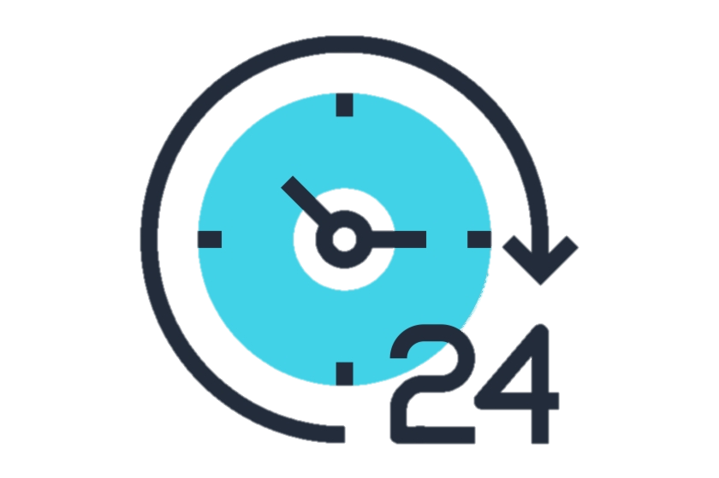
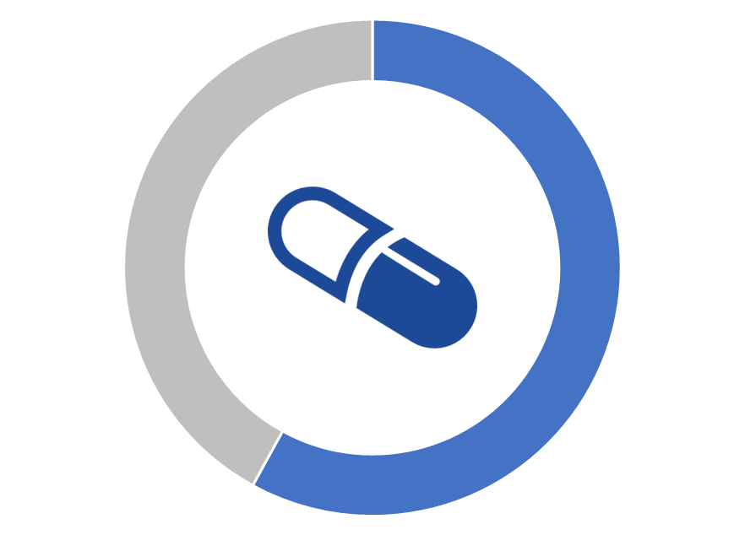


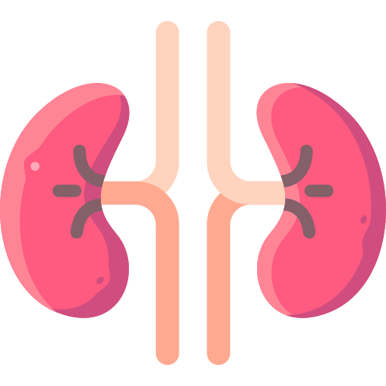
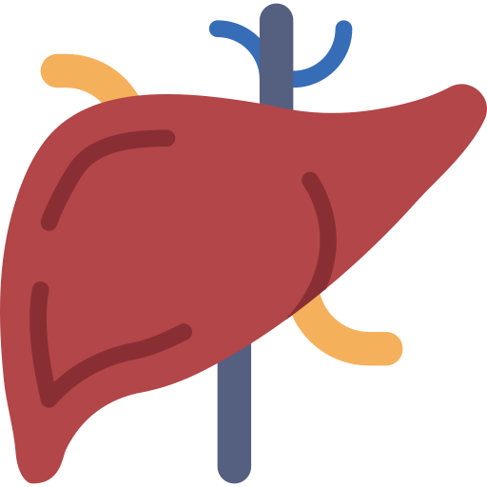

MICARDIS® (telmisartan)
Pharmacokinetics overview ¹⁻³
42-58%
0.5 – 1 hr
Shortest T_{max}*
Longest t_{1/2} *
Bioavailability
Largest volume of distribution (L)*
70 – 100%
The least renal execration <1%
no dose adjustment with renal impairment*
T/P Ratio#
Does not metabolite by C-P450
No active metabolite
* Compared to all ARB drugs: Azilsartan, Candesartan, Eprosartan, Irbesartan, Losartan, Olmesartan and Valsartan
# Compared to all ARB drugs: higher than T/P ratio of eprosartan (65 – 80%), losartan (50-90%), olmesartan(60 – 80%)and valsartan (60-70%) , while equal to candesartan (70 – 100%), irbesartan (70 – 100%), and valsartan (≥80%).
ARB : angiotensin receptor blocker, t_{1/2 :}half-life, T_{max}: time-to-maximum, T/P: trough: peak ratio.
1. Asmar R. Targeting effective blood pressure control with angiotensin receptor blockers. Int J Clin Pract. 2006;60(3):315-320. 2. Israili ZH. Clinical pharmacokinetics of angiotensin II (AT1) receptor blockers in hypertension. J Hum Hypertens. 2000;14. Suppl 1:S73-S86.3. MICARDIS prescribing information, Boehringer Ingelheim, 2018.

Slide 49
MICARDIS® (telmisartan)
Requires no dose adjustment with renal impairment patients¹
35-50%
35%
33%
42%
Olmesartan
Azilsartan
Losartan
Candesartan
20%
20%
10%
<1%
Irbesartan
Valsartan
Eprosartan
Telmisartan
MICARDIS® has the least renal execration <1% requiring no dose adjustment with renal impairment.
1. Israili ZH. Clinical pharmacokinetics of angiotensin II (AT1) receptor blockers in hypertension. J Hum Hypertens. 2000;14. Suppl 1:S73-S86. 2. MICARDIS prescribing information, Boehringer Ingelheim, 2018.

Slide 50


MICARDIS® (telmisartan) provides sustained BP control even after a missed dose¹
Due to its longer half-life, MICARDIS® (telmisartan) offers more sustained BP control, especially at the last 6 hours of the dosing period.¹
Missed
dose
48 hours after initial dose
SBP reduction from baseline (mmHg)
0
-1
Telmisartan 80mg
Valsartan 160mg
-3
Day 1
n=877
Day 2
n=868
-5
p=0.0286
-7
p=0.0095
-9
-11
-13
p=0.0001
-15
p=0.0126
10 12 14 16 18 20 22 24 26 28 30 32 34 36 38 40 42 44 46 48
Time after an active dose (hours)
0
2
4
6
8
1. Lacourcière Y, Krzesinski JM, White WB, Davidai G, Schumacher H. Sustained antihypertensive activity of telmisartan compared with valsartan. Blood Press Monit. 2004;9(4):203-210. doi:

Slide 51
5. ANTIHYPERTENSIVE BEYOND BENEFITS
Cardiovascular Protection

Slide 52

Large evidence base for ARBs in CV outcomes trials
MICARDIS® (telmisartan) has been intensively studied in >50 000 patients in CV outcomes trials; (TRANSCEND, PRoFESS, & ONTARGET)
HIJ-CREATE DIRECT
NAVIGATOR KYOTO GISSI-AF
Jikei
60
CASE-J TROPHY CHARM SCOPE
51 818
51 878
MOSES
Enrolled patients (thousands)
50
5926
VALUE VALIANT VAL-HeFT
ROADMAP
9306
HEAAL OPTIMAAL LIFE RENAAL ELITE II ELITE
40
3031
ACTIVE-I
I-PRESERVE IDNT-ARB
3081
1442
20 332
TRANSCEND PRoFESS ONTARGET
30
15 245
IRMA-2
23 903
23 440
20
3846
2049
5477
3326
4728
15 449
14 703
25 620
9193
772
9016
10
7601
1513
4128
4449
5010
3152
722
4964
1715
590
1405
0
Valsartan
Telmisartan
Losartan
Candesartan
Irbesartan
Olmesartan
Eprosartan
ARB: Angiotensin receptor blocker , CV: cardiovascular.
1. Volpe M. Preventing cardiovascular events with angiotensin II receptor blockers: a closer look at telmisartan and valsartan. Expert Rev Cardiovasc Ther. 2012;10(8):1061-1072.

Slide 53
ARBs provide CV protection beyond BP reduction
Meta-analysis of 4 trials (n=16 791) comparing ARBs with control regimens¹
RR (95% CI)
0.79 (0.69–0.90)
P value
0.46
Stroke
Coronary heart disease
0.96 (0.85–1.09)
0.84 (0.72–0.97)
0.43
0.26
Heart failure
Major CV events
0.90 (0.83–0.96)
0.78
CV death
0.96 (0.85–1.08)
0.34
Total mortality
0.94 (0.86–1.02) 0.59
Favours ARB
Favours control
0.5
1.0
RR
2.0
Risks of stroke, heart failure, and major cardiovascular events were lower
with ARBs compared with control regimens.
ARB: Angiotensin receptor blocker , BP: blood pressure, CV: cardiovascular.
1.Turnbull F; Blood Pressure Lowering Treatment Trialists' Collaboration. Effects of different blood-pressure-lowering regimens on major cardiovascular events: results of prospectively-designed overviews of randomised trials. Lancet. 2003;362(9395):1527-1535.

Slide 54

Meta-analysis demonstrated ARBs reduced stroke risk by 8% vs ACE inhibitors¹
Meta-analysis of 6 trials comparing ARBs (n=31 632) with ACE inhibitors (n=18 292)¹
ARBs vs ACE inhibitors
ELITE 1997
ELITE-II 2000
OPTIMAAL 2002
DETAIL 2004
VALIANT/Val 2003
ONTARGET/Tel 2008
RR (95% CI)
1.41 (0.31–6.33)
1.64 (0.77–3.48)
1.06 (0.83–1.35)
1.09 (0.34–3.47)
0.85 (0.69–1.04)
0.91 (0.79–1.05)
0.93 (0.84–1.03)
0.93 (0.84–1.03)
Fixed effects model (I²=0.0%, P=0.478) Random effects model
ARBs + AEC inhibitors vs ACE inhibitors
VALIANT/Val + Cap 2003 ONTARGET/Tel + Ram 2008
Fixed effects model (I²=0.0%, P=0.602) Random effects model
0.87 (0.71–1.06)
0.93 (0.80–1.07)
0.91 (0.81–1.02)
0.91 (0.81–1.02)
Overall estimate
Fixed effects model (I²=0.0%, P=0.670) Random effects model
0.92 (0.85–0.99)
0.92 (0.85–0.99)
Favours 1st listed
Favours 2nd listed
Heterogeneity between groups: P=0.714
0.5
1.0
RR
2.0
ACE: Angiotensin converting enzyme, ARB: Angiotensin receptor blocker, BP: Blood pressure.
1. Reboldi G, Angeli F, Cavallini C, Gentile G, Mancia G, Verdecchia P. Comparison between angiotensin-converting enzyme inhibitors and angiotensin receptor blockers on the risk of myocardial infarction, stroke and death: a meta-analysis. J Hypertens. 2008;26(7):1282-1289.

Slide 55














Overview of MICARDIS® (telmisartan) clinical trials along the cardiovascular continuum.
Remodelling
Ventricular Dilation/
Cognitive Dysfunction
Myocardial Infarction & Stroke
Congestive Heart Failure/
Secondary Stroke
Micro- albuminuria
Macro- proteinuria
Atherosclerosis and LVH
Nephrotic Proteinuria
End-Stage Heart Disease/
Brain Damage and Dementia
Endothelial Dysfunction
End-Stage Renal Disease
Hypertension risk factors: diabetes, obesity, elderly
Cardio/
Cerebrovascular Death
1. Dzau V. The cardiovascular continuum and renin-angiotensin-aldosterone system blockade. J Hypertens Suppl. 2005;23(1):S9-S17.

Slide 56
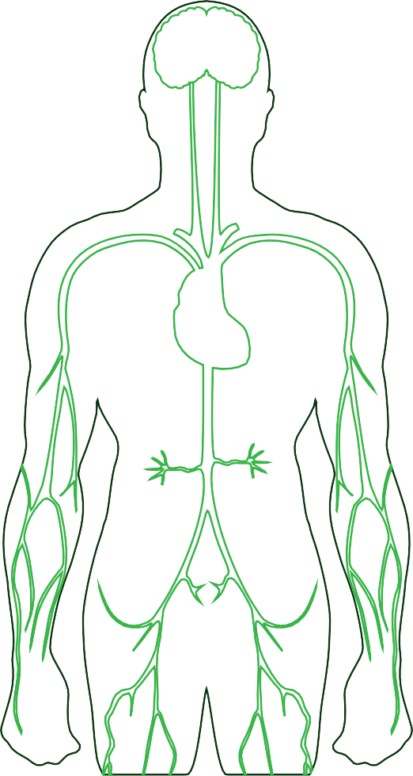
ARBs offers improved therapeutic efficacy, safety, and tolerability vs other regimens
Less stroke vs ACE inhibitors*²
Reduced composite CV endpoints vs control regimens¹
Reduced left ventricular
hypertrophy³
Less new-onset diabetes vs diuretics¹
Less proteinuria⁴
AE profile similar to placebo⁵
Higher persistence vs other regimens⁶
* Ramipril
1. Telmisartan Randomised AssessmeNt Study in ACE iNtolerant subjects with cardiovascular Disease (TRANSCEND) Investigators, Yusuf S, Teo K, et al. Effects of the angiotensin-receptor blocker telmisartan on cardiovascular events in high-risk patients intolerant to angiotensin-converting enzyme inhibitors: a randomised controlled trial [published correction appears in Lancet. 2008 Oct 18;372(9647):1384]. Lancet. 2008;372(9644):1174-1183. 2. ONTARGET Investigators, Yusuf S, Teo KK, et al. Telmisartan, ramipril, or both in patients at high risk for vascular events. N Engl J Med. 2008;358(15):1547-1559. 3. Verdecchia P, Sleight P, Mancia G, et al. Effects of telmisartan, ramipril, and their combination on left ventricular hypertrophy in individuals at high vascular risk in the Ongoing Telmisartan Alone and in Combination With Ramipril Global End Point Trial and the Telmisartan Randomized Assessment Study in ACE Intolerant Subjects With Cardiovascular Disease. Circulation. 2009;120(14):1380-1389. 4. Bakris G, Burgess E, Weir M, Davidai G, Koval S; AMADEO Study Investigators. Telmisartan is more effective than losartan in reducing proteinuria in patients with diabetic nephropathy. Kidney Int.2008;74(3):364-369. 5. Schumacher H, Mancia G. The safety profile of telmisartan as monotherapy or combined with hydrochlorothiazide: a retrospective analysis of 50 studies. Blood Press Suppl. 2008;1:32-40. 6. Bloom BS. Continuation of initial antihypertensive medication after 1 year of therapy. Clin Ther. 1998;20(4):671-681.

Slide 57
The ONTARGET Trial
Cardiovascular Protection

Slide 58

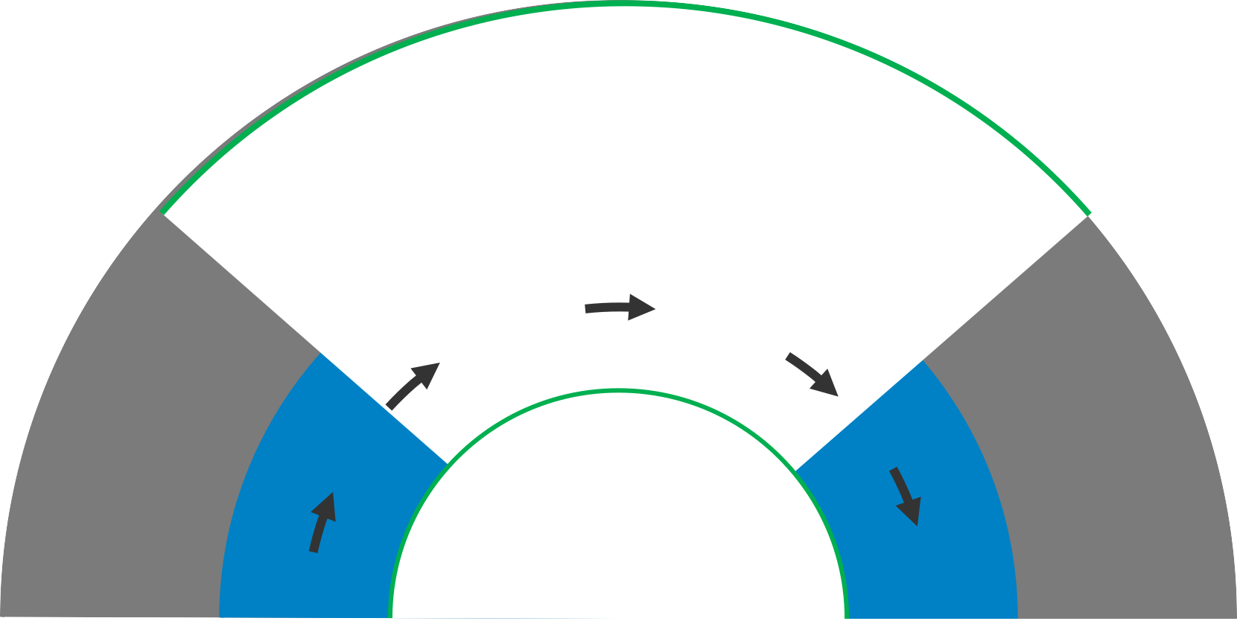

Clinical Evidence With ARBs BEFORE ONTARGET^{®1-7}
CV high risk
???
Heart failure
VALIANT⁴
Hypertension
CHARM⁵
MI and stroke
Remodelling
Val-HeFT⁶ ELITE II⁷
LIFE²
Ventricular dilation/ cognitive dysfunction
Micro- albuminuria
Macro- proteinuria
Atherosclerosis and LVH
Nephrotic proteinuria
CHF/
secondary stroke
Endothelial dysfunction
Risk factors: hypertension, diabetes, obesity, smoking, age
ESRD
Cardio/ cerebrovascular death
Adapted from ref. 8,9
1. ONTARGET Investigators, Yusuf S, Teo KK, et al. Telmisartan, ramipril, or both in patients at high risk for vascular events. N Engl J Med. 2008;358(15):1547-1559. 2. Dahlöf B, Devereux RB, Kjeldsen SE, et al. Cardiovascular morbidity and mortality in the Losartan Intervention For Endpoint reduction in hypertension study (LIFE): a randomised trial against atenolol. Lancet. 2002;359(9311):995-1003. 3. Julius S, Kjeldsen SE, Brunner H, et al. VALUE trial: Long-term blood pressure trends in 13,449 patients with hypertension and high cardiovascular risk. Am J Hypertens. 2003;16(7):544-548. 4. Velazquez EJ, Pfeffer MA, McMurray JV, et al. VALsartan In Acute myocardial iNfarcTion (VALIANT) trial: baseline characteristics in context. Eur J Heart Fail. 2003;5(4):537-544. 5. Pfeffer MA, Swedberg K, Granger CB, et al. Effects of candesartan on mortality and morbidity in patients with chronic heart failure: the CHARM-Overall programme [published correction appears in Lancet. 2009 Nov 21-2009 Nov 27;(9703):1744]. Lancet. 2003;362(9386):759-766. 6. Cohn JN, Tognoni G; Valsartan Heart Failure Trial Investigators. A randomized trial of the angiotensin-receptor blocker valsartan in chronic heart failure. N Engl J Med. 2001;345(23):1667-1675. 7. Pitt B, Poole-Wilson P, Segal R, et al. Effects of losartan versus captopril on mortality in patients with symptomatic heart failure: rationale, design, and baseline characteristics of patients in the Losartan Heart Failure Survival Study--ELITE II. J Card Fail. 1999;5(2):146-154. 8. Dzau VJ, Antman EM, Black HR, et al. The cardiovascular disease continuum validated: clinical evidence of improved patient outcomes: part I: Pathophysiology and clinical trial evidence (risk factors through stable coronary artery disease). Circulation. 2006;114(25):2850-2870. 9. Dzau V, Braunwald E. Resolved and unresolved issues in the prevention and treatment of coronary artery disease: a workshop consensus statement. Am Heart J. 1991;121(4 Pt 1):1244-1263.
Telmisartan plus Amlodipine Medical Education Slide Ressource: FINAL Version 1.0 (30-June-2010)

Slide 59
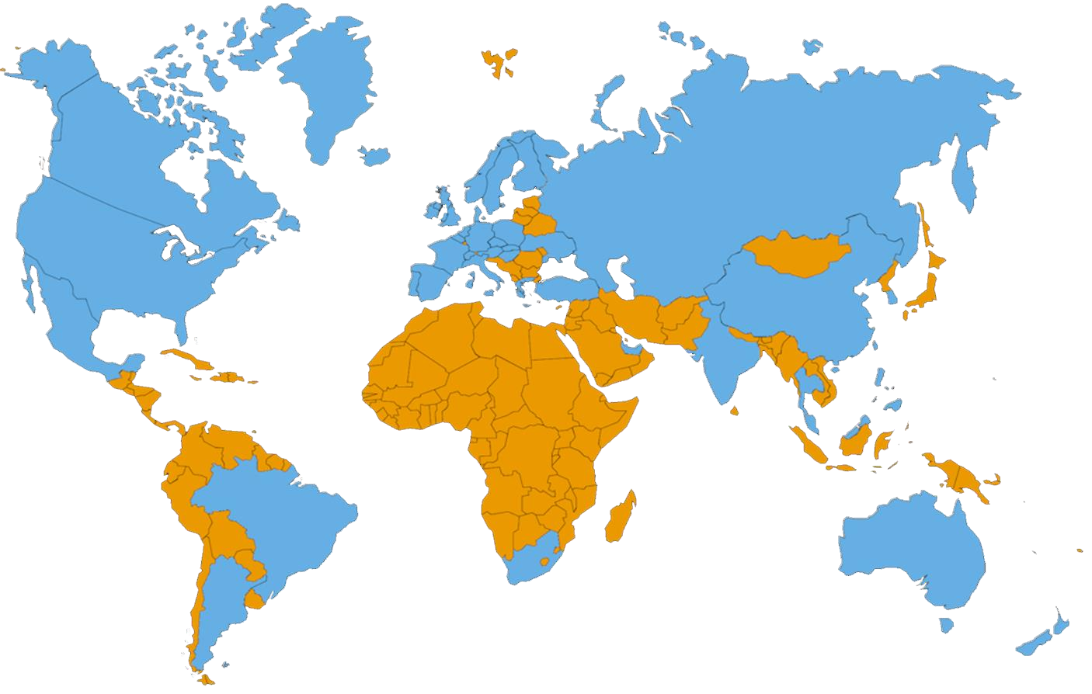
The ONTARGET Trial Programme
A Global Trial
Europe
23 countries¹
North America 3 countries¹
Asia
9 countries¹
Africa
1 country¹
South America 2 countries¹
Australasia
2 countries¹
1. ONTARGET Investigators, Yusuf S, Teo KK, et al. Telmisartan, ramipril, or both in patients at high risk for vascular events. N Engl J Med. 2008;358(15):1547-1559.

Slide 60





The ONTARGET Trial Programme
Study design¹
ONTARGET TRANSCEND
Screening
Randomisation(n=23,400)*
Randomisation(n=6,000)†
n = 7,800
Telmisartan 80 mg/day + placebo
n = 7,800
Ramipril 10 mg/day +
placebo
n = 7,800
Telmisartan 80 mg/day + Ramipril 10mg/day
n = 3,000
Telmisartan 80 mg/day
n = 3,000
Placebo
5.5 Years
Follow-up at 6 weeks
Follow-up at 6 weeks
Follow-up at
6 months for 5.5 years
Follow-up at
6 months for 5.5 years
*planned. Actual = 25,620
†planned. Actual = 5962
1. Teo K, Yusuf S, Sleight P, et al. Rationale, design, and baseline characteristics of 2 large, simple, randomized trials evaluating telmisartan, ramipril, and their combination in high-risk patients: the Ongoing Telmisartan Alone and in Combination with Ramipril Global Endpoint Trial/Telmisartan Randomized Assessment Study in ACE Intolerant Subjects witah Cardiovascular Disease (ONTARGET/TRANSCEND) trials. Am Heart J. 2004;148(1):52-61. 2. Telmisartan Randomised AssessmeNt Study in ACE iNtolerant subjects with cardiovascular Disease (TRANSCEND) Investigators, Yusuf S, Teo K, et al. Effects of the angiotensin-receptor blocker telmisartan on cardiovascular events in high-risk patients intolerant to angiotensin- converting enzyme inhibitors: a randomised controlled trial [published correction appears in Lancet. 2008 Oct 18;372(9647):1384]. Lancet. 2008;372(9644):1174-1183.

Slide 61
The ONTARGET Trial Programme Prospective RCT, non-inferior study¹
Inclusion criteria
Age ≥55 years¹
Outcomes
Primary composite cardiovascular endpoint:¹
Cardiovascular mortality
Non-fatal myocardial infarction
Hospitalisation for congestive heart failure
Non-fatal stroke
At high risk of developing a CVD event, with a history of:¹
Coronary artery disease
Peripheral arterial occlusive disease (PAOD) Cerebrovascular event
Diabetes mellitus with end-organ damage
Intolerant to ACE inhibitors
(TRANSCEND only)²
:
1. ONTARGET Investigators, Yusuf S, Teo KK, et al. Telmisartan, ramipril, or both in patients at high risk for vascular events. N Engl J Med. 2008;358(15):1547-1559. 2. Teo K, Yusuf S, Sleight P, et al. Rationale, design, and baseline characteristics of 2 large, simple, randomized trials evaluating telmisartan, ramipril, and their combination in high-risk patients: the Ongoing Telmisartan Alone and in Combination with Ramipril Global Endpoint Trial/Telmisartan Randomized Assessment Study in ACE Intolerant Subjects with Cardiovascular Disease (ONTARGET/TRANSCEND) trials. Am Heart J. 2004;148(1):52-61.
26

Slide 62
The ONTARGET Trial Programme
Exclusion criteria
Medication use¹
Inability to discontinue ACE inhibitors or ARB
Known hypersensitivity or intolerance to ACE inhibitors or ARB
Congestive heart failure
Hemodynamically significant valvular or outflow tract
obstruction
Constrictive pericarditis
Complex congenital heart disease
Syncopal episodes of unknown etiology <3 months
Planned cardiac surgery or PTCA < 3 months
Uncontrolled hypertension on treatment (eg, BP >160/100 mm Hg)
Heart transplant recipient
Stroke due to subarachnoid hemorrhage
Cardiovascular disease¹
Significant renal artery disease
Hepatic dysfunction
Uncorrected volume or sodium depletion
Primary hyperaldosteronism
Hereditary fructose intolerance
Other major noncardiac illness or expected to reduce life
expectancy or significant disability interfere with study participation
Simultaneously taking another experimental drug
Other conditions¹
1. ONTARGET Investigators, Yusuf S, Teo KK, et al. Telmisartan, ramipril, or both in patients at high risk for vascular events. N Engl J Med. 2008;358(15):1547-1559. Supplementary Appendix. .

Slide 63
The ONTARGET Trial Programme
Baseline characteristics¹
ONTARGET TRANSCEND
Medications (% of patients) | (n=25,620) | (n=5,304*)
Demography
Age (years) | 66.4 | 67.0
Male (%) | 73.3 | 57.5
Physical Exam
BP at run-in (mm Hg) | 143\82 | 142\82
BP at randomisation (mm Hg) | 134\77 | 135\78
Body mass index | 28.2 | 28.3
Waist–hip ratio | 0.9 | 0.9
Medical History
Hypertension | 68.3 | 75.0
MI | 48.7 | 46.3
Stable angina | 34.8 | 36.5
Stroke/TIA | 20.7 | 21.6
Claudication | 11.8 | 10.2
Diabetes | 37.3 | 35.0
Current smoker | 12.5 | 9.5
* TRANSCEND as of January 2004. Final TRANSCEND recruitment, n=5,926
1. Sleight P. The ONTARGET/TRANSCEND Trial Programme: baseline data. Acta Diabetol. 2005;42 Suppl 1:S50-S56.

Slide 64
The ONTARGET Trial Programme
Baseline characteristics – medication use¹
ONTARGET
TRANSCEND
 | (n=25,620) | (n=5,304*)
Medications (% of patients)
ACE Inhibitors | 57.5 | 57.9
Angiotensin Receptor Blockers | 8.6 | 30.0
Beta-blockers | 56.9 | 57.6
Diuretics | 27.9 | 32.6
Nitrates | 29.2 | 34.5
Calcium channel blockers
- Diltiazem/verapamil | 9.7 | 10.1
- Other | 23.8 | 31.0
Antiplatelets
- ASA | 75.6 | 74.3
- Ticlodipine | 2.5 | 2.6
- Clopidogrel | 8.5 | 8.0
Oral anticoagulants | 7.6 | 7.2
Statins | 60.7 | 54.4
Insulin | 10.4 | 7.3
Oral hypoglycaemics | 25.0 | 23.7
* TRANSCEND as of January 2004. Final TRANSCEND recruitment, n=5,926²
1. Sleight P. The ONTARGET/TRANSCEND Trial Programme: baseline data. Acta Diabetol. 2005;42 Suppl 1:S50-S56. 2. Telmisartan Randomised AssessmeNt Study in ACE iNtolerant subjects with cardiovascular Disease (TRANSCEND) Investigators, Yusuf S, Teo K, et al. Effects of the angiotensin-receptor blocker telmisartan on cardiovascular events in high-risk patients intolerant to angiotensin-converting enzyme inhibitors: a randomised controlled trial [published correction appears in Lancet. 2008 Oct 18;372(9647):1384]. Lancet. 2008;372(9644):1174-1183.
29

Slide 65
ONTARGET compared clinical outcomes for MICARDIS® (telmisartan) vs ramipril in patients at high vascular risk
ONTARGET
Ongoing telmisartan alone and in combination with ramipril global end-point trial
Telmisartan 80 mg
N=8576
Patients with coronary, peripheral, or cerebrovascular disease or diabetes with end-organ damage¹
Ramipril 10 mg
N=8542
Telmisartan 80 mg + Ramipril 10 mg
N=8502
Median follow up 56 months
Primary endpoint: Composite of CV death, MI, stroke, or hospitalisation for heart failure¹
1. ONTARGET Investigators, Yusuf S, Teo KK, et al. Telmisartan, ramipril, or both in patients at high risk for vascular events. N Engl J Med. 2008;358(15):1547-1559.

Slide 66




Why compared MICARDIS® (telmisartan) with ramipril in ONTARGET?
HOPE study Primary composite outcomes (CV death, MI or stroke)¹
MI, stroke CV death
Death from CV causes
MI
Stroke
% risk reduction for treatment versus placebo
-10
-20
–20%
P<0.001
–22%
P<0.001
–26%
P<0.001
-30
–32%
P<0.001
-40
%
Ramipril, n=4645; Placebo, n=4652
CV: cardiovascular, MI: myocardial infraction.
1. Heart Outcomes Prevention Evaluation Study Investigators, Yusuf S, Sleight P, et al. Effects of an angiotensin-converting-enzyme inhibitor, ramipril, on cardiovascular events in high-risk patients [published correction appears in 2000 May 4;342(18):1376] [published correction appears in N Engl J Med 2000 Mar 9;342(10):748]. N Engl J Med. 2000;342(3):145-153

Slide 67

ONTARGET: the risk of CV events was similar for patients receiving MICARDIS® (telmisartan) vs ramipril
Composite of CV death, MI, stroke, or hospitalisation for heart failure¹
0.20
Telmisartan (80 mg)
Ramipril (10 mg) Telmisartan plus Ramipril*
Cumulative hazard ratio
0.15
0.10
Incidence of primary outcome:¹
Telmisartan Ramipril Combination
16.7%
16.5%
16.3%
0.05
0.00
0
1
2 3
Years of follow-up
4
5
N at risk
Telmisartan | 8542 | 8177 | 7778 | 7420 | 7051 | 1687
Ramipril | 8576 | 8214 | 7832 | 7472 | 7093 | 1703
Telmisartan plus ramipril | 8502 | 8133 | 7738 | 7375 | 7022 | 1718
*Combination therapy (telmisartan plus ramipril) was associated with increased AEs; as a result, this combination is not recommended.
CV: cardiovascular, MI: myocardial infraction.
1. ONTARGET Investigators, Yusuf S, Teo KK, et al. Telmisartan, ramipril, or both in patients at high risk for vascular events. N Engl J Med. 2008;358(15):1547-1559.

Slide 68
MICARDIS® (telmisartan) is the only ARB approved for CV prevention
(based on evidence from the ONTARGET trial program)
Hypertension
Cardiovascular Prevention
Heart failure or LVSD
Renal disease in Hypertension with T2DM
Reduction of Stroke in Hypertension with LVH
Hyperten- sion
Diabetes with | Coronary |  | Peripheral
target organ | Heart | Stroke | Arterial
damage ✓ | Disease ✓ | ✓ | Disease ✓
Telmisartan¹
✓
Candesartan²
✓
✓
Valsartan³
✓
✓
Olmesartan⁴
✓
Azilsartan⁵
✓
Eprosartan⁶
✓
Irbesartan⁷
✓ ✓
Losartan⁸
✓ ✓ ✓
✓
T2DM: type 2 diabetes mellitus, LVH: Left ventricular hypertrophy, LVSD: left ventricular systolic dysfunction.
1. MICARDIS (Telmisartan) summary of product characteristics,EMA. 2. Atacand (candesartan cilexetil) Prescribing information, AstraZeneca, 2009. 3. Diovan (Valsartan) prescribing information, Novartis, 2011. 4. BENICAR (olmesartan medoxomil) prescribing information, Daiichi Sankyo, Inc, 2017. 5. EDARBI ((azilsartan medoxomil) Summary of product characteristics. 6. TEVETEN (eprosartan mesylate) prescribing information, Abbvie Inc., 2014. 7. Aprovel (Irbesartan), summary of product characteristics, 2020. 8. COZAAR (losartan potassium)prescribing information, Merck & Co., Inc., 2019.

Slide 69
The TRANSCEND Trial
Cardiovascular Protection

Slide 70
TRANSCEND compared the CV risk reduction profile of MICARDIS® (telmisartan) vs placebo in patients at high vascular risk who were intolerant to ACE inhibitors
TRANSCEND
Telmisartan randomized assessment study in ACE intolerant subjects with cardiovascular Disease¹
Patients intolerant
to ACE inhibitors with coronary, peripheral, or cerebrovascular disease or diabetes with end-organ damage¹
Telmisartan 80 mg
N=2954
Placebo
N=2972
Median follow up 56 months
Primary endpoint: Composite of CV death, MI, stroke, or hospitalisation for heart failure¹
ACE: angiotensin converting enzyme, CV: cardiovascular, MI: myocardial infraction
1. Telmisartan Randomised AssessmeNt Study in ACE iNtolerant subjects with cardiovascular Disease (TRANSCEND) Investigators, Yusuf S, Teo K, et al. Effects of the angiotensin-receptor blocker telmisartan on cardiovascular events in high-risk patients intolerant to angiotensin-converting enzyme inhibitors: a randomised controlled trial [published correction appears in Lancet. 2008 Oct 18;372(9647):1384]. Lancet. 2008;372(9644):1174-1183.

Slide 71
TRANSCEND: MICARDIS® (telmisartan) reduced the risk of MI in hypertensive patients¹
In hypertensive patients, but not in nonhypertensive ones,
MICARDIS® (telmisartan) demonstrated a 27% risk reduction in MI compared with placebo¹
Non-hypertensive subgroup
HR=1.16 (95% CI=0.59–2.31); P=0.66
Hypertensive subgroup
HR=0.73 (95% CI=0.56–0.95); P=0.02
0.06
0.05
0.04
0.03
0.02
0.01
Cumulative incidence (%)
0.06
0.05
0.04
0.03
0.02
0.01
Cumulative incidence (%)
Telmisartan Placebo
4 5
Telmisartan Placebo
0.00
0.00
4
5
0
1
2 3
Years of follow-up
0
1
2 3
Years of follow-up
No difference in the effect of treatment between hypertensive and nonhypertensive patients for primary composite endpoint (CV death, MI, stroke, hospitalization for heart failure)¹
CV: cardiovascular, MI: myocardial infraction
1. Foulquier S, Böhm M, Schmieder R, et al. Impact of telmisartan on cardiovascular outcome in hypertensive patients at high risk:
a Telmisartan Randomised AssessmeNt Study in ACE iNtolerant subjects with cardiovascular Disease subanalysis. J Hypertens. 2014;32(6):1334-1341.

Slide 72
TRANSCEND: MICARDIS® (telmisartan) vs placebo in prevalence and new development of left ventricular hypertrophy
Prevalence of LVH
at baseline and after 2 and 5 years
Overall OR=0.79 (95% CI=0.68–0.91); P=0.0017
New development of LVH
at 2 and 5 years
Overall OR=0.63 (95% CI=0.51–0.79); P=0.001
14
8
12.8
7.8
Prevalence of left ventricular hypertrophy (%)
12
12.7
12.7
12.8
Prevalence of left ventricular hypertrophy (%)
7
10
6
6.0
10.5
9.8
5
8
4.9
4
4.0
6
3
4
2
2
1
0
0.0
0.0
Basal Year 2 Year 5
2688 2647 2279
Telmisartan
Basal Year 2 Year 5
2655 2600 2220
0
Basal Year 2 Year 5
2347 2311 2008
Telmisartan
Basal Year 2 Year 5
2314 2265 1949
N. patients
N. patients
Placebo
Placebo
Overall 21% reduction in LVH risk with MICARDIS® (telmisartan) vs placebo¹
Overall 37% reduction in LVH risk at follow up with MICARDIS® (telmisartan) vs placebo¹
Left ventricular hypertrophy: LVH
1. Verdecchia P, Sleight P, Mancia G, et al. Effects of telmisartan, ramipril, and their combination on left ventricular hypertrophy in individuals a high vascular risk in the Ongoing Telmisartan Alone and in Combination With Ramipril Global End Point Trial and the Telmisartan Randomized Assessment Study in ACE Intolerant Subjects With Cardiovascular Disease. Circulation. 2009;120(14):1380-1389.

Slide 73

ANTIHYPERTENSIVE BEYOND BENEFITS:
Reno- Protection

Slide 74
ONTARGET: Renal outcomes of MICARDIS® (telmisartan) vs. Ramipril in people at high vascular risk¹
Change in urine albumin to creatinine ratio from baseline values (%)
35
P=0.033
30
25
Telmisartan Ramipril
20
P=0.0013
15
10
Number of participants with measurements:¹
5
Baseline: 2 years:
21,076
19,397
0
Study end: 16,098
2-year increase
Final increase
Urine albumin increased at 2 years and at study end to a lesser extent in participants assigned MICARDIS® (telmisartan) vs those assigned ramipril.¹
The geometric mean of urine albumin excretion at baseline ranged between 0·81 mg/mmol and 0·83 mg/mmol creatinine and was not different between the randomized groups.
1. Mann JF, Schmieder RE, McQueen M, et al. Renal outcomes with telmisartan, ramipril, or both, in people at high vascular risk (the ONTARGET study): a multicentre, randomised, double- blind, controlled trial. Lancet. 2008;372(9638):547-553.

Slide 75
AMADEO: MICARDIS® (telmisartan) is more effective than losartan at reducing proteinuria.¹
gMean UPC (mg/g creatinine)
2400
2200
2000
1800
Telmisartan (n=407)
Losartan (n=420)
The reduction in UPC from baseline was greater for telmisartan vs losartan (P=0.03)¹
1600
1400
1200
1000
P=0.027
Baseline
13
26
Weeks
39
52
Both MICARDIS® (telmisartan) (29.8%; P<0.0001) and losartan (21.4%; P<0.0001) significantly reduced mean UPC at 52 weeks¹
UPC = Urinary Protein to Creatinine
1. Bakris G, Burgess E, Weir M, Davidai G, Koval S; AMADEO Study Investigators. Telmisartan is more effective than losartan in reducing proteinuria in patients with diabetic nephropathy. Kidney Int. 2008;74(3):364-369.

Slide 76
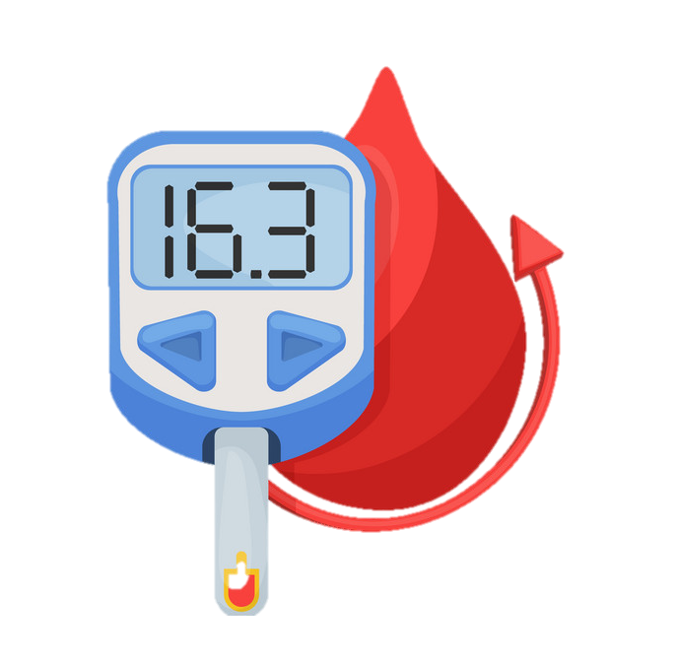
ANTIHYPERTENSIVE BEYOND BENEFITS:
New Onset of Diabetes Reduction

Slide 77


Network meta-analysis demonstrated that ARBs are effective at reducing new-onset diabetes¹
Comparison of antihypertensive regimens vs initial diuretic from 22 trials (n=143 153)
OR (95% CI)
P value
ARB
0.57 (0.46–0.72)
<0.0001
ACE inhibitor
0.67 (0.56–0.80)
<0.0001
CCB
0.75 (0.62–0.90)
0.002
Placebo
0.77 (0.63–0.94)
0.009
β blocker
0.90 (0.75–1.09) 0.30
Referent
Incoherence=0.000017
Diuretic
0.05
0.70 0.90 1.26
OR
With diuretic regimen as reference, this meta-analysis showed that ARBs and ACE inhibitors are the antihypertensive agents least associated with incident diabetes¹
Circle size is proportional to the number of patients who developed incident diabetes
1. Elliott WJ, Meyer PM. Incident diabetes in clinical trials of antihypertensive drugs: a network meta-analysis [published correction appears in Lancet. 2007 May 5;369(9572):1518]. Lancet. 2007;369(9557):201-207.

Slide 78
TRANSCEND and PRoFESS trials demonstrated the trend of MICARDIS® (telmisartan) to reduce new-onset diabetes^{1,2}
TRANSCEND
Patients with CAD, PAD, cerebrovascular
disease, or diabetes with end-organ damage¹
PRoFESS
Patients with ischemic stroke in previous 90 days or 120 days with ≥2 additional risk factors²
15
HR 0.85 (0.71-1.02); P=0.081
5
New onset diabetes (%)
New onset diabetes (%)
12.8
4
10
11.0
3
2
HR 0.82 (0.65-1.04); P=0.10
5
1
1.2
1.5
0
0
Telmisartan (n=2954)
Placebo (n=2972)
Telmisartan (n=10,146)
Placebo (n=10,186)
In both trials, there was a nonsignificant trend toward a lower rate of new-onset diabetes associated with MICARDIS® (telmisartan) vs placebo.^{1,2}
1. Telmisartan Randomised AssessmeNt Study in ACE iNtolerant subjects with cardiovascular Disease (TRANSCEND) Investigators, Yusuf S, Teo K, et al. Effects of the angiotensin-receptor blocker telmisartan on cardiovascular events in high-risk patients intolerant to angiotensin-converting enzyme inhibitors: a randomised controlled trial [published correction appears in Lancet. 2008 Oct 18;372(9647):1384]. Lancet. 2008;372(9644):1174-1183. 2. Yusuf S, Diener HC, Sacco RL, et al. Telmisartan to prevent recurrent stroke and cardiovascular events. N Engl J Med. 2008;359(12):1225-1237.

Slide 79
ARBs are associated with higher levels of persistence vs other antihypertensive agents¹
P<0.007 (n=21 723)
70
64
60
58
50
After 1 year, a significant number of patients continued on ARB therapy vs other antihypertensive regimes.1
Compliance at 1 year (%)
50
43
40
38
30
20
10
0
Diuretics Beta-blockers CCBs ACE inhibitors ARBs
*This was a retrospective cohort study, which included only the records of patients who were naïve to antihypertensive therapy. Data were from the longitudinal Merck-Medco (Waverly, New Jersey) Disease Management.¹
1. Bloom BS. Continuation of initial antihypertensive medication after 1 year of therapy. Clin Ther. 1998;20(4):671-681.

Slide 80
Further research highlights additional distinguishing features of MICARDIS® (telmisartan) in CV protection¹⁻³
Study objective: evaluate the underlying mechanisms of telmisartan vs ramipril on advanced atherosclerotic lesions.¹
Mouse model of advanced atherosclerosis
Atherosclerotic lesion size reduction:
38% with telmisartan vs 18% with ramipril¹
Signs of plaque instability reduced in telmisartan-treated mice¹
Fewer macrophages in telmisartan-treated mice¹
Anti-inflammatory and antioxidant properties of telmisartan may contribute to its therapeutic properties and indicate distinct properties of this ARB both within its class and within the RAS-blocking agents ^{2,3}
ACE: angiotensin converting enzyme, ARB: angiotensin receptor blockers, CV: cardiovascular, RAS : renin- angiotensin system
1.Blessing, E., Preusch, M., Kranzhöfer, R.et. al., 2008. Anti-atherosclerotic properties of telmisartan in advanced atherosclerotic lesions in apolipoprotein E deficient mice. Atherosclerosis, 199(2), pp.295-303. 2. Unger, T., 2012. Preclinical and clinical effects of RAS inhibition with a focus on telmisartan. International Scholarly Research Notices, 2012. 3. Cianchetti, S., Del Fiorentino, A., Colognato, R., et. al., 2008. Anti-inflammatory and anti-oxidant properties of telmisartan in cultured human umbilical vein endothelial cells. Atherosclerosis, 198(1), pp.22-28.

Slide 81
6. SINGLE PILLS COMBINATION

Slide 82
ESH/ESC recommendations for triple combination therapy
Thiazide diuretics¹
Angiotensin-receptor blockers¹
β-blockers¹
Other antihypertensives¹
Calcium antagonists ¹
preferred combinations
useful combination (with some limitations) Possible but less well-tested combinations
not recommended combination
ACE-inhibitors¹
For patients whose BP is not controlled by two-drug combination therapy, the logical option is to increase treatment to three-drug combination therapy: usually a RAS blocker, a CCB, and a diuretic.²
CCB: calcium channel blocker, RAS : renin- angiotensin system
: 1. Mancia G, Fagard R, Narkiewicz K, et al. 2013 ESH/ESC Practice Guidelines for the Management of Arterial Hypertension.Blood Press. 2014;23(1):3-16. 2. Williams B, Mancia G, Spiering W, et al. 2018 ESC/ESH Guidelines for the management of arterial hypertension [published correction appears in Eur Heart J. 2019 Feb 1;40(5):475]. Eur Heart J. 2018;39(33):3021-3104.

Slide 83

CCB + ARB: The Synergies of Counter-Regulation
CCB
ARB
Balanced dilatation of arteries and Veins²
Attenuates peripheral oedema⁵
Effective in high-renin patients⁶
Arteriodilation¹
Peripheral oedema²
Effective in low-renin patients³
Reduces cardiac ischaemia⁴
CCB
ARB
RAS activation⁷
No renal or CHF benefits⁷
RAS blockade²
CHF and renal benefits ⁵
BP
Synergistic BP reduction
Complementary clinical benefits
CHF: congestive heart failure, RAS : renin- angiotensin system
1. Lin Y, Ma L. Blood pressure lowering effect of calcium channel blockers on perioperative hypertension: A systematic review and meta-analysis. Medicine (Baltimore). 2018;97(48):e13152. 2. Mistry NB, Westheim AS, Kjeldsen SE. The angiotensin receptor antagonist valsartan: a review of the literature with a focus on clinical trials. Expert Opin Pharmacother. 2006;7(5):575-581. 3. Bühler FR, Bolli P, Kiowski W, Erne P, Hulthén UL, Block LH. Renin profiling to select antihypertensive baseline drugs. Renin inhibitors for high-renin and calcium entry blockers for low-renin patients. Am J Med. 1984;77(2A):36-42. 4. Sueta D, Tabata N, Hokimoto S. Clinical roles of calcium channel blockers in ischemic heart diseases. Hypertens Res. 2017;40(5):423-428. 5. Oparil S, Weber M. Angiotensin receptor blocker and dihydropyridine calcium channel blocker combinations: an emerging strategy in hypertension therapy. Postgrad Med. 2009;121(2):25-39. 6. Brown MJ. Renin: friend or foe?. Heart. 2007;93(9):1026-1033. 7. Sica DA. Rationale for fixed-dose combinations in the treatment of hypertension: the cycle repeats. Drugs. 2002;62(3):443-462. doi:10.2165/00003495-200262030-00003.

Slide 84
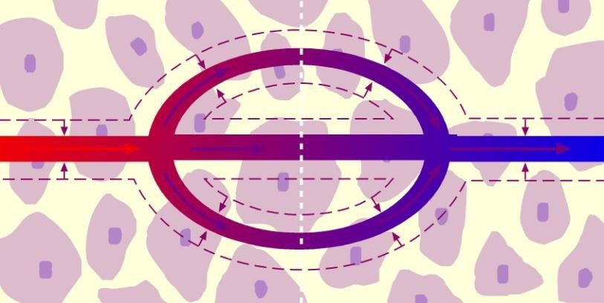
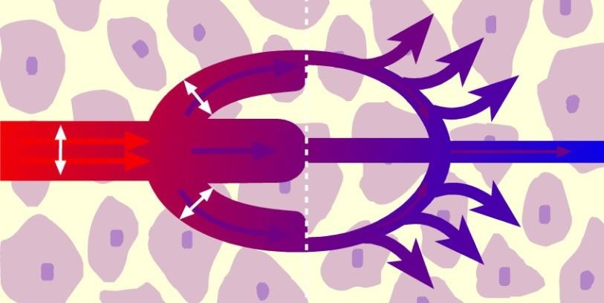
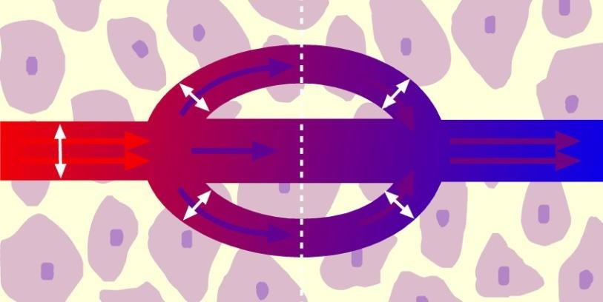
Reduced oedema by Co-administration of ARBs with CCB
Arterial hypertension
Constricted blood vessels¹
CCBs
Calcium channel blockers dilate arteries to a greater extent than veins, thus increasing capillary pressure and causing fluid to collect in interstitial spaces¹
CCBs + RAS inhibitors*
Normalized pressure gradient
ARBs reduce the lower extremity edema induced by CCBs because they decrease fluid volume (via inhibition of the RAAS) and dilate both arterial and venous capillary beds¹
Afferent arteriole
Efferent arteriole
CCB: calcium channel blocker, RAAS: renin- angiotensin aldosterone system, RAS : renin- angiotensin system
1. Oparil S, Weber M. Angiotensin receptor blocker and dihydropyridine calcium channel blocker combinations: an emerging strategy in hypertension therapy. Postgrad Med. 2009;121(2):25-39

Slide 85
TWYNSTA® (telmisartan + amlodipine) Provides Consistently
High BP Reductions in Hypertensive at-Risk Patients¹
Obese BMI ≥30kg/m¹
(n = 175)
Metabolic syndrome¹* (n = 36)
Elderly
≥ 65 y¹
(n = 100)
Severe HTN
≥ 180/95 mmHg¹
(n = 379)
Diabetic¹
(n = 62)
Black¹
(n = 30)
0
T80/A10
Mean SBP reductions from baseline (mmHg)
-10
-20
-30
-40
TWYNSTA reduce BP more than 40mmHg in all type risk of hypertension.¹
-50
-43.2
-44.2
-46.1
-46.8
-46.6
-47.5
-60
Mean baseline BP = 185.4/103.2 mmHg
* Diabetes, obesity (BMI ≥ 30kg/m²), and HTN
BP: blood pressure
1. Neutel JM, Mancia G, Black HR, et al. Single-pill combination of telmisartan/amlodipine in patients with severe hypertension: results from the TEAMSTA severe HTN study. J Clin Hypertens (Greenwich). 2012;14(4):206-215.

Slide 86
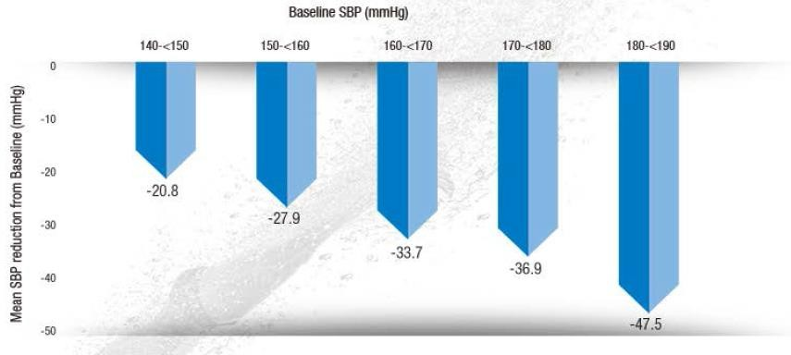
Powerful of TWYNSTA® (telmisartan + amlodipine) in BP reductions needed to get hypertensive patients to GOAL
Mean systolic BP reductions after 8 weeks of treatment with TWYNSTA® 80/10 mg
Adapted from ref. 1
BP: blood pressure
1. Suárez C. Single-pill telmisartan and amlodipine: a rational combination for the treatment of hypertension. Drugs. 2011;71(17):2295-2305. 2. Neutel JM, Mancia G, Black HR, et al. Single-pill combination of telmisartan/amlodipine in patients with severe hypertension: results from the TEAMSTA severe HTN study. J Clin Hypertens (Greenwich).
2012;14(4):206-215

Slide 87
Blood pressure response in up to 99.7% of Patients with TWYNSTA*¹
TWYNSTA® (telmisartan + amlodipine) blood pressure Response Rates¹
SBP response* No SBP response
99.7%
* SBP < 140 mmHg or ≥ 10 mmHg reduction; T80/A10 (n = 395)¹
SBP: Systolic blood pressure
1. Neutel JM, Mancia G, Black HR, et al. Single-pill combination of telmisartan/amlodipine in patients with severe hypertension: results from the TEAMSTA severe HTN study. J Clin Hypertens (Greenwich). 2012;14(4):206-215.

Slide 88
TWYNSTA® (telmisartan + amlodipine) is Associated With Less Peripheral Oedema Compared With Amlodipine 10 mg¹
p < 0.0001
p < 0.0001
20
Patients with peripheral oedema (%)
17.8
15
–90%
–71%
10
5.2
5
1.7
0
A10
(n = 124)
T40–80+A5
(n = 264)
T40–80+A5–A10
(n = 543)
A: amlodipine, T:telmisartan.
1. Littlejohn TW 3rd, Majul CR, Olvera R, et al. Results of treatment with telmisartan- amlodipine in hypertensive patients. J Clin Hypertens (Greenwich). 2009;11(4):207-213.

Slide 89
DISCLAIMER
The following data are indirect comparisons of placebo controlled studies. Although all studies investigated hypertensive patients, the study designs varied. No statistical conclusions about superiority or inferiority, of one or the other product, can be drawn from these indirect comparisons

Slide 90

TWYNSTA® (Telmisartan+Amlodipine) vs Valsartan+Amlodipine
Indirect Comparison of BP Reductions at Comparable Baseline BP values*^{1,2}
Agent | Baseline BP
Valsartan with:² 5 mg amlodipine 10 mg amlodipine | 153/99 mmHg 157/99 mmHg
Agent | Baseline BP
Telmisartan+Amlodipine (all doses)¹ | 153/102 mmHg
T40/A5
T40/A10
T80/A5
T80/A10
V160/A5
V160A10
V320/A5
V320/A10
0
0
-5
-5
†
-10
†
-10
-7.6
mmHg
-10.3
mmHg
-9.0
-9.3
-9.9
-12.0
-15
-14.0
-13.9
-15
-13.2
-15.5
-16.2
-15.9
-20
-19.3
-19.6
-20
-25
-22.2
SBP
DBP
-23.9
-25
SBP
DBP
Adapted from ref. 1
Adapted from ref. 2
* Indirect comparisons: study design varied; †Placebo-corrected values
DBP: diastolic blood pressures: Systolic blood pressure
1.Twynsta (telmisartan/amlodipine) prescribing information, Boehringer Ingelheim Pharmaceuticals Inc., 2009. 2. Exforge (amlodipine and valsartan) prescribing information, Novartis Pharmaceuticals, 2012.

Slide 91

TWYNSTA® (Telmisartan+Amlodipine) vs Olmesartan+Amlodipine
Indirect Comparison of BP Reductions at Comparable Baseline BP values*
Agent | Baseline BP
Telmisartan+Amlodipine (all doses)¹ | 167/103 mmHg
Agent | Baseline BP
Olmesartan+Amlodipine (all doses)² | 164/102 mmHg
T40/A5
T40/A10
T80/A5
T80/A10
O20/A5
O20/A10
O40/A5
O40/A10
0
0
-5
-5
-10
-10
†
-9.8
†
-11
mmHg
-15
-12.4
-13.4
mmHg
-15
-14
-13
-15.3
-16
-20
-20
-20
-25
-22.0
-22.4
-25
-22
-25
-26
-30
-27.6
-28.9
-30
-35
SBP
DBP
-35
SBP
DBP
Adapted from ref. 1
Adapted from ref. 2
* Indirect comparisons: study design varied; †Placebo-corrected values
DBP: diastolic blood pressures: Systolic blood pressure
1.Factorial design study (data on file; Boehringer Ingelheim Pharmaceuticals, Inc. 2. Azor [prescribing information]. Parsippany, NJ: Daiichi Sankyo, Inc; 2009.

Slide 92
Telmisartan+Amlodipine vs Competitors
Incidence of Peripheral Oedema Compared With Amlodipine 10 mg
Patients with peripheral oedema after 8 weeks of treatment (%)
40
35
– 42%3
30
TWYNSTA®
Telmisartan/Amlodipine combination significantly reduces patents’ oedema incidence ¹
25
20
36.8
– 71%¹
15
– 50%²
10
17.8
21.4
5
0
10.3
5.2
5.1
A10 T40–80/ A5–10
A10 V160–320/
A5–10
A10 O20–40/ A5–10
* Indirect comparisons: study design varied; †Placebo-corrected values
1. Littlejohn TW 3rd, Majul CR, Olvera R, et al. Results of treatment with telmisartan-amlodipine in hypertensive patients. J Clin Hypertens (Greenwich). 2009;11(4):207-213. 2. Exforge summary of product charcteristics (EMA). 3. Chrysant SG, Melino M, Karki S, Lee J, Heyrman R. The combination of olmesartan medoxomil and amlodipine besylate in controlling high blood pressure: COACH, a randomized, double-blind, placebo-controlled, 8-week factorial efficacy and safety study. Clin Ther. 2008;30(4):587-604.

Slide 93
Summary: Benefits of Telmisartan go beyond BP lowering
1
The CV disease continuum begins with risk factors, such as hypertension, which initiate a cascade of processes cumulating in target-organ damage and CV events¹
Pivotal clinical trials have demonstrated that ARBs
2
(e.g. MICARDIS® (telmisartan) provide CV and target organ protection vs other antihypertensive regimens or placebo²⁻⁵
Especially, MICARDIS® (telmisartan) is the only ARB to prove indication in ‘Prevent of CV morbidity and mortality’.⁶⁻¹³
3
Increase persistence with Single pill combination in long term treatment.^{14,15}
Dzau VJ, Antman EM, Black HR, et al. The cardiovascular disease continuum validated: clinical evidence of improved patient outcomes: part I: Pathophysiology and clinical trial evidence (risk factors through stable coronary artery disease). Circulation. 2006;114(25):2850-2870.
ONTARGET Investigators, Yusuf S, Teo KK, et al. Telmisartan, ramipril, or both in patients at high risk for vascular events. N Engl J Med. 2008;358(15):1547-1559. 3. Telmisartan Randomised AssessmeNt Study in ACE iNtolerant subjects with cardiovascular Disease (TRANSCEND) Investigators, Yusuf S, Teo K, et al. Effects of the angiotensin-receptor blocker telmisartan on cardiovascular events in high-risk patients intolerant to angiotensin-converting enzyme inhibitors: a randomised controlled trial [published correction appears in Lancet. 2008 Oct 18;372(9647):1384]. Lancet. 2008;372(9644):1174-1183. 4. Foulquier S, Böhm M, Schmieder R, et al. Impact of telmisartan on cardiovascular outcome in hypertensive patients at high risk: a Telmisartan Randomised AssessmeNt Study in ACE iNtolerant subjects with cardiovascular Disease subanalysis. J Hypertens. 2014;32(6):1334-1341. 5. Verdecchia P, Sleight P, Mancia G, et al. Effects of telmisartan, ramipril, and their combination on left ventricular hypertrophy in individuals at high vascular risk in the Ongoing Telmisartan Alone and in Combination With Ramipril Global End Point Trial and the Telmisartan Randomized Assessment Study in ACE Intolerant Subjects With Cardiovascular Disease. Circulation. 2009;120(14):1380-1389. 6. MICARDIS (Telmisartan) summary of product characteristics,EMA. 7. Atacand (candesartan cilexetil) Prescribing information, AstraZeneca, 2009. 8. Diovan (Valsartan) prescribing information, Novartis, 2011. 9. BENICAR (olmesartan medoxomil) prescribing information, Daiichi Sankyo, Inc, 2017. 10. EDARBI ((azilsartan medoxomil) Summary of product characteristics. 11. TEVETEN (eprosartan mesylate) prescribing information, Abbvie Inc., 2014. 12. Aprovel (Irbesartan), summary of product characteristics, 2020. 13. COZAAR (losartan potassium)prescribing information, Merck & Co., Inc., 2019. 14. Bloom BS. Continuation of initial antihypertensive medication after 1 year of therapy. Clin Ther. 1998;20(4):671-681. 15. Maillard MP, Burnier M. Is the fixed-dose combination of telmisartan and hydrochlorothiazide a good approach to treat hypertension?. Vasc Health Risk Manag. 2007;3(3):265-278.

Slide 94
Thank You

